Slide 1

A Talk by Arjun Kathuria

Slide 2

How I hand-coded core Machine learning Algorithms from scratch in python, what i learned, and why you should too.

Slide 3

About the Speaker (Me)
Hi,
I am Arjun Kathuria, an independent software developer and hacker from New Delhi, India.
I was a Google summer of code student 2016 with jQuery Foundation.
I held the position of the sole lead frontend software developer for a high growth startup in Bangalore from early 2017 to mid 2018, which i left to follow and pursue my other interests in computer science and music.
My current interests include python, machine learning, full-stack development, lower level Kernel stuff, Rust and Lisp.
Github: github/arjunkathuria
Twitter: @arjunslays
insta: @arjunslays
email: arjun.kathuria8@gmail.com

Slide 4
The premise
The WHY

Slide 5
Just like any field of science, Machine Learning too has certain basic concepts and algorithms that act as the fundamental building blocks of everything wonderful you see around you. From your Youtube recommendations to your phone cameras, its everywhere.
Fortunately, these algorithms have been made available to us for use as wonderfully optimized, properly packaged and easy-to-use abstractions, think scikit-learn and friends.
We essentially treat and use them as BLACKBOXES!
Import a classifier already made for you from the library, throw your training data at it and BOOM, you can make predictions on new data now and well be on your way..
Believe it or not, that is a MAGNIFICENT thing. This is a massive win for practicality, pragmatism and performance.
BUT to Me, it seemed a bit too much of magic.
So I decided to pop the hood and look inside. This talk takes gives you a crisp take on what followed and what I found and presents you with what I learned along the way.

Slide 6
Chapter 1
Demystifying Machine learning.

Slide 7
WHAT is machine learning ?

Slide 8
I’ll do you one better
WHO is machine learning ?

Slide 9
Yea? I’ll do you one even better…

Slide 10
WHY is machine learning ?!

Slide 11
What one extreme of the spectrum believes what Machine Learning is
.
.
.

Slide 12


Slide 13
What the other extreme of the spectrum believes what Machine Learning is
.
.
.

Slide 14


Slide 15
Well, Yes and No.
Its somewhere in the middle
The fundamentals of machine learning are still true to core statistics, but in practice, as of today, it has grown into something much bigger (as we will see).

Slide 16
When you zoom out and tune out the noise
Machine learning pertains to extraction of knowledge from data by building intelligent (often self-learning) agents / systems in order to make predictions.
In its simplest form -

Slide 17
Chapter 2 :
Machine Learning, The Big Picture.

Slide 18
All the cool stuff that you hear about. The wicked ML algorithms, the fancy sounding classifiers, the Neural Networks, They are just one part - The learning part - of a much larger picture of the ML field.
These different processes can broadly be classified into 4 sections
Data pre-processing.
Learning.
Evaluation.
Prediction.

Slide 19
Machine learning systems: The Big Picture

Slide 20
Machine Learning, a broad field.
Machine Learning
Supervised Learning
Unsupervised Learning
Reinforcement Learning
Labeled data
Predicts outcome
Eg: Classifiers like spam filters, text / character recognition
Unlabelled data
Finds hidden structure in data
Eg: Clustering, user segmentation etc.
Interacts with environment.
Decision process based on a reward system
Eg: Game playing agents.

Slide 21
Supervised learning in a 🥜 🐚
Labelled Training Data
Machine Learning Algorithm
New Data
Predictive Model
Prediction

Slide 22
Chapter 3: The Algorithms

Slide 23
The classification algorithms to be covered
The Perceptron classifier algorithm + The Adaline algorithm
Logistic Regression

Slide 24
Dataset
The ubiquitous Iris dataset is used for all code and examples in the talk
The dataset consists of 150 rows or measurements of the Iris flowers of 3 different species, namely - Virginica, Setosa and Versicolor - (50 of each) and it measures 4 of the flower features for each measurement.
The Sepal length [cm]
The Sepal Width [cm]
Petal Length [cm]
Petal Width [cm]

Slide 25
Data Shape
 | Sepal Length | Sepal Width | Petal length | petal width | Class Label
1 | 5.1 | 3.5 | 1.4 | 0.2 | Iris-setosa
2 . | 4.9 . | 3.0 . | 1.4 . | 0.2 . | iris-setosa .
. 57 . | . 6.5 . | . 3.4 . | . 4.5 . | . 1.2 . | . iris-versicolor .
. 149 | . 6.2 | . 3.4 | . 5.4 | . 2.3 | . iris-virginica
150 | 5.9 | 3.0 | 5.1 | 1.8 | iris-virginica
Incidently, in terms of $x_{(m)}^{(n)}$, $x_{(1)}^{(150)}$ would refer to the 1st column/feature of sample
Number 150.

Slide 26
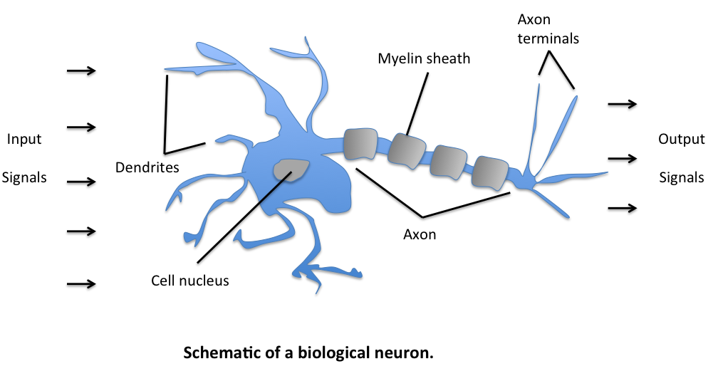
Modelling the artificial neuron
So, how a biological neuron works is, it receives multiple signals from the dendrites. Now if the total strength of signal exceeds a certain threshold, an output signal is generated and passed on by the axon terminals.
This, artificially can be modelled as a logic gate with a binary output, indicating if the input exceeds the given threshold. 1 if it does, 0 if it doesn’t.

Slide 27
Artificial Neuron applied to a classification task.
(WIP)

Slide 28
The Perceptron Algorithm
One of the earliest classification algorithms known for binary classification. It was Published by Frank Rosenblatt and was amongst the first algorithmically described ML Algorithm for classification. It was based on the MCP(McCulloch–Pitts) model of a neutron.
Overview of How it works without getting into the math.
Initialise a set of weights (numbers, often random) equal to the number of features on the training set. i.e 1:1 mapping from a feature vector to a weight vector.
For each training sample
Calculate the net input by linear combination of the weight and feature vectors. net input is also sometimes known as weighted input.
If the net input is greater than a threshold, predict class A else predict class B (or not of class A), often numerically coded as 1 and -1. computationally, this is done by a decision function.
Update the weights based on the perceptron learning rule, so that it is more accurate the next time.
$$x^{(i)}$$

Slide 29
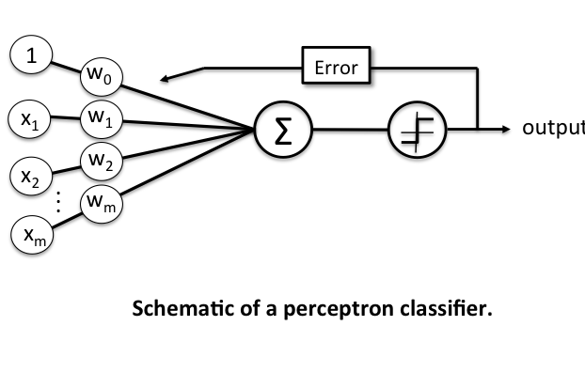
The Schematic
Net input /
weighted input
Decision
function

Slide 30
*A refresher on vectors
So, the vectors have about 2 major understanding systems / ideas associated with them which we primarily know as:
The Physics Perspective
The Computer Science perspective
The Physics Perspective
The Physics Perspective treats vectors as essentially Arrows pointing in space. What defines a given vector is its length(magnitude) and the direction it is pointing. As long as those two are same, the arrow can be moved around in space and still be the same vector. The vectors in a flat plane are 2-dimensional and vectors residing in a 3-d space are 3-D vectors and so on. The ones you studied in school.
The CS Perspective
The CS Perspective defines vectors as ORDERED list of numbers. To oversimplify, vectors in CS are just a fancy word for a list. A 2 dimensional vector simply means the length of the list is 2. Mind == Blown right ? For Eg:- (see next page)

Slide 31
Suppose you are modelling houses as vectors and all you care about are the house no, sq. footage, and the price.
$$\left[\begin{aligned}15\text{h. no} \\ \text{₹}100 \\ 2500{\text{ft}}^{2}\end{aligned}\right]$$
}
$$\left[\begin{aligned}15\text{h. no} \\ \text{₹}100 \\ 2500{\text{ft}}^{2}\end{aligned}\right]≠\left[\begin{aligned}15\text{h. no} \\ \text{₹}2500 \\ 100{\text{ft}}^{2}\end{aligned}\right]$$
=
= 3 Dimensional
*Since order is important
Operations on vectors
Vector Addition:-
Vectors can be added to other vectors and the result is a new vector
$$\left[\begin{aligned}2 \\ 3\end{aligned}\right]+\left[\begin{aligned}5 \\ 6\end{aligned}\right]=\left[\begin{aligned}2+5 \\ 3+6\end{aligned}\right]=\left[\begin{aligned}7 \\ 9\end{aligned}\right]$$
Vector scalar multiplication:-
Multiplying vectors with numbers, SCALES the vector, thus the name SCALAR.
It is equivalent to multiplying each element of the vector with the number individually.
$2×\left[\begin{aligned}3 \\ 5\end{aligned}\right]=\left[\begin{aligned}2*3 \\ 2*5\end{aligned}\right]=\left[\begin{aligned}6 \\ 10\end{aligned}\right]$

Slide 32
Terminology and Components of Perceptron Learning Rule.
Input Vector / Input matrix / Input values:- the data values as a vector/matrix/rows
Weight Vector:- a column vector containing weights for each dimension of input value.
Net input:- The linear combination of the input values (x) and the weight vector (w)
$$w=\left[\begin{aligned}w_{1} \\ . \\ . \\ . \\ w_{m}\end{aligned}\right]andx=\left[\begin{aligned}x_{1} \\ . \\ . \\ . \\ x_{m}\end{aligned}\right],$$
then the net input
$$z=w_{1}x_{1}+w_{2}x_{2}+...+w_{m}x_{m}$$
$$w^{T}=\left[\begin{aligned}w_{1}...w_{m}\end{aligned}\right]andx=\left[\begin{aligned}x_{1} \\ . \\ . \\ . \\ x_{m}\end{aligned}\right],$$
more concisely, we can say
$$z=w^{T}x$$
Where

Slide 33
* A Refresher on Matrices and Matrix Multiplications
$$w^{n×m}=\left[\begin{aligned}x_{1}^{(1)}x_{2}^{(1)}...x_{m}^{(1)} \\ x_{1}^{(2)}x_{2}^{(2)}...x_{m}^{(2)} \\ . \\ . \\ . \\ x_{1}^{(n)}x_{2}^{(n)}...x_{m}^{(n)}\end{aligned}\right]$$
Matrices with a single row (1 x m) are called row vectors, $w=\left[\begin{aligned}w_{1}...w_{m}\end{aligned}\right]$
Matrices with a single columns (n x 1) are called column vectors $w=\left[\begin{aligned}w_{1} \\ . \\ . \\ . \\ w_{m}\end{aligned}\right]$
Is a ( n x m ) matrix with n rows and m columns (features)
The rule for matrix multiplication, however, is that two matrices can be multiplied only when the number of columns in the first equals the number of rows in the second (i.e., the inner dimensions are the same, m for an (n×m)-matrix times an (m×p)-matrix, resulting in an (n×p)-matrix
$${\left[\begin{aligned}123 \\ 456\end{aligned}\right]}^{(2×3)}×{\left[\begin{aligned}7 \\ 8 \\ 9\end{aligned}\right]}^{(3×1)}=\left[\begin{aligned}1×7+2×8+3×9 \\ 4×7+5×8+6×9\end{aligned}\right]=\left[\begin{aligned}50 \\ 122\end{aligned}\right]$$

Slide 34
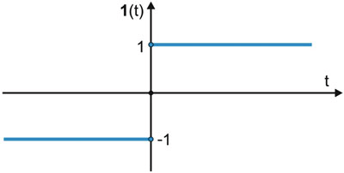
Now, in context of binary classification task, if the net input of a particular sample is greater than a defined threshold θ, we predict class 1, else class -1.
In case of perceptron, the decision function is a variant of the step function.
$$ϕ(z)=\{_{-1otherwise}^{1ifz≥θ}$$
Where
$$z=w^{T}x$$
(Linear combination)
*Now, for simplicity, if we take the Threshold $θ$ to the left side of the inequality in the equation, we can define a weight-zero where $w_{0}=-θ\text{and}x_{0}=1$, such that $w_{0}x_{0}=-θ$, we can write $Z$ more succinctly as:-
$z=w_{0}x_{0}+w_{1}x_{1}+...w_{m}x_{m}=w^{T}x$ AND $ϕ(z)=\{_{-1otherwise}^{1ifz≥0}$
In Machine Learning, this weight-zero or negative threshold $w_{0}=-θ$ is called the BIAS UNIT. This makes the weight vector size 1 + sizeof(x features)

Slide 35
Perceptron learning rule
The value for updating the weights at each increment is calculated by the learning rule
$$w=w+Δw_{j}$$
WHERE
= Weight Update
$$Δw_{j}$$
$$Δw_{j}=η(target^{(i)}-output^{(i)})x_{j}^{(i)}$$
$$η$$
= Learning Rate
, the learning rate (a constant between 0.0 and 1.0), “target” is the true class label, and the “output” is the predicted class label.
$$η$$
In the cases where the perceptron predicts the class label correctly, the weights remain unchanged:
$$Δw_{j}=η(1^{(i)}-1^{(i)})x_{j}^{(i)}=0$$
when true class label is 1 and the prediction is also 1
$$Δw_{j}=η(-1^{(i)}--1^{(i)})x_{j}^{(i)}=0$$
when true class label is -1 and the prediction is also -1

Slide 36
In the case of wrong prediction, the weights are “PUSHED” towards the direction of the positive or negative target class, respectively:
$$Δw_{j}=η(1^{(i)}--1^{(i)})x_{j}^{(i)}=η(2)x_{j}^{(i)}$$
when true class label is 1 and the prediction is -1
$$Δw_{j}=η(-1^{(i)}-1^{(i)})x_{j}^{(i)}=η(-2)x_{j}^{(i)}$$
when true class label is -1 and the prediction is 1
NOTE
it is important to note that all weights in the weight vector are being updated simultaneously. thus, for a 2-dimensional dataset, the updates would update each weight individually:
$$Δw_{1}=η(target^{(i)}-output^{(i)})x_{1}^{(i)}$$
$$Δw_{2}=η(target^{(i)}-output^{(i)})x_{2}^{(i)}$$
Example for Intuition:-
Let us assume that $x_{j}^{(i)}$ = 0.5 is misclassified as -1, we would increase the corresponding weight by a positive factor, so that the next time around the net output is more likely to be above the threshold of the unit step function and be classified correctly as 1
Also, the weight is proportional to the value of $x_{j}^{(i)}$, I.e bigger the misclassification, bigger the correction. For eg if $x_{j}^{(i)}$ were = 2 that was incorrectly classified as -1, the decision boundary will be pushed even further.
$$Δw_{j}=(1--1)0.5=(2)0.5=1$$
$$Δw_{j}=(1--1)2=(2)2=4$$

Slide 37
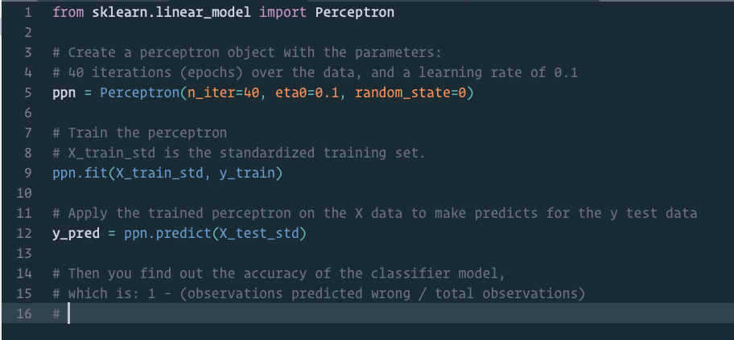
Python Code to train a perceptron model imported form sci-kit learn library

Slide 38
What we need:-
We need to initialize a Perceptron class instance with some given parameters
The learning rate (eta \ $η$).
The number of iterations after which to stop.
A random state as a seed to the random number generator for weights, for consistent reproducibility.
That instance must contain:-
A Fit method :- which fits the model on training data
A Predict method :- which predicts the classification of new data.
Some sort of metric to calculate efficiency / Accuracy of model.

Slide 39
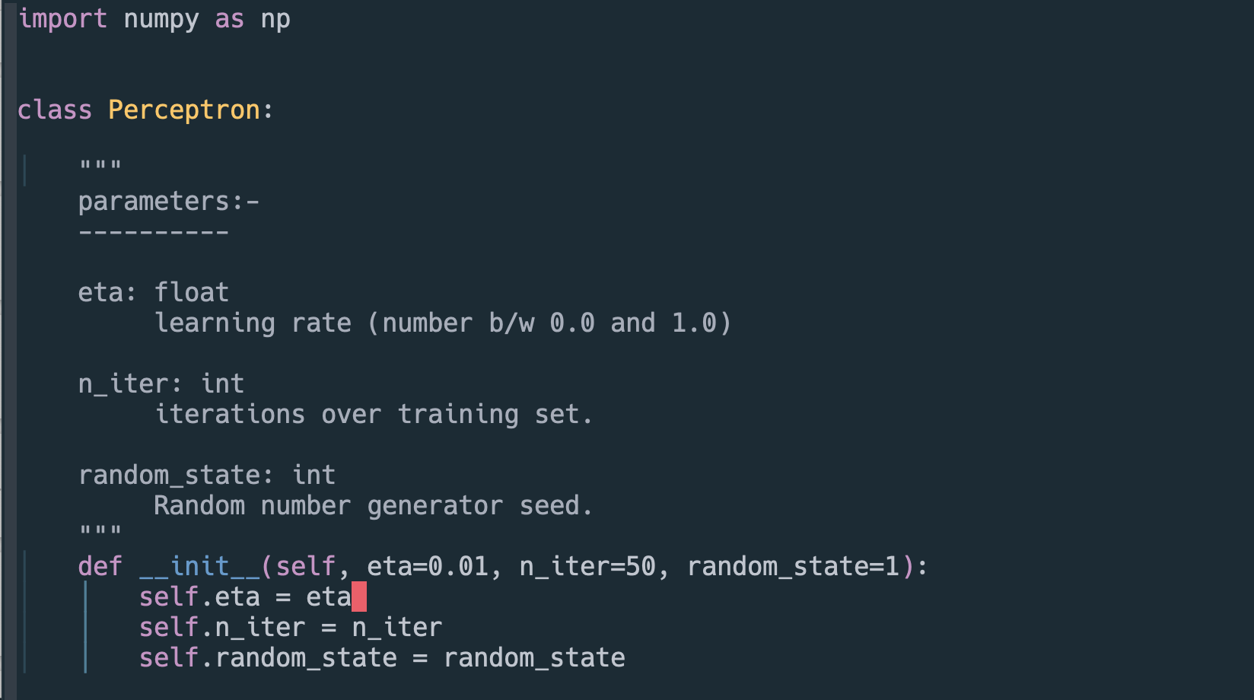
Writing your own Perceptron Classifier in Python
The init method

Slide 40
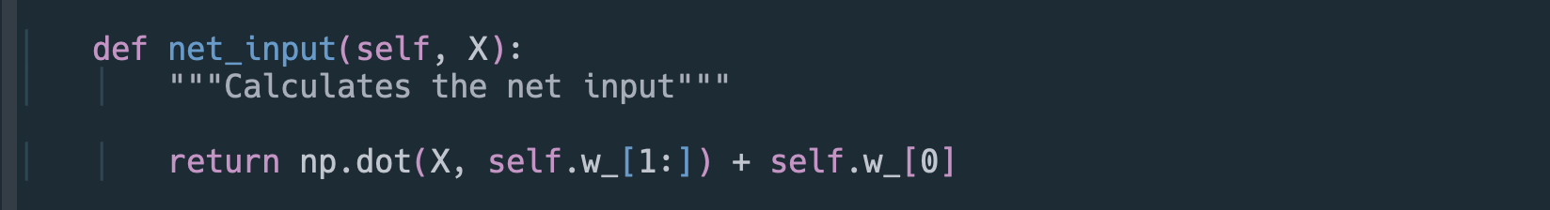
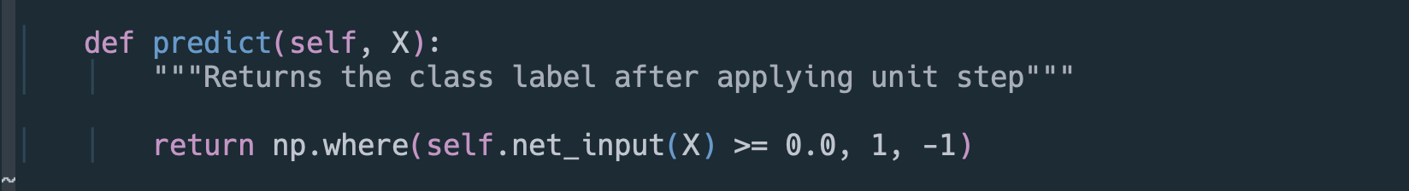
The net_input method
The predict method

Slide 41
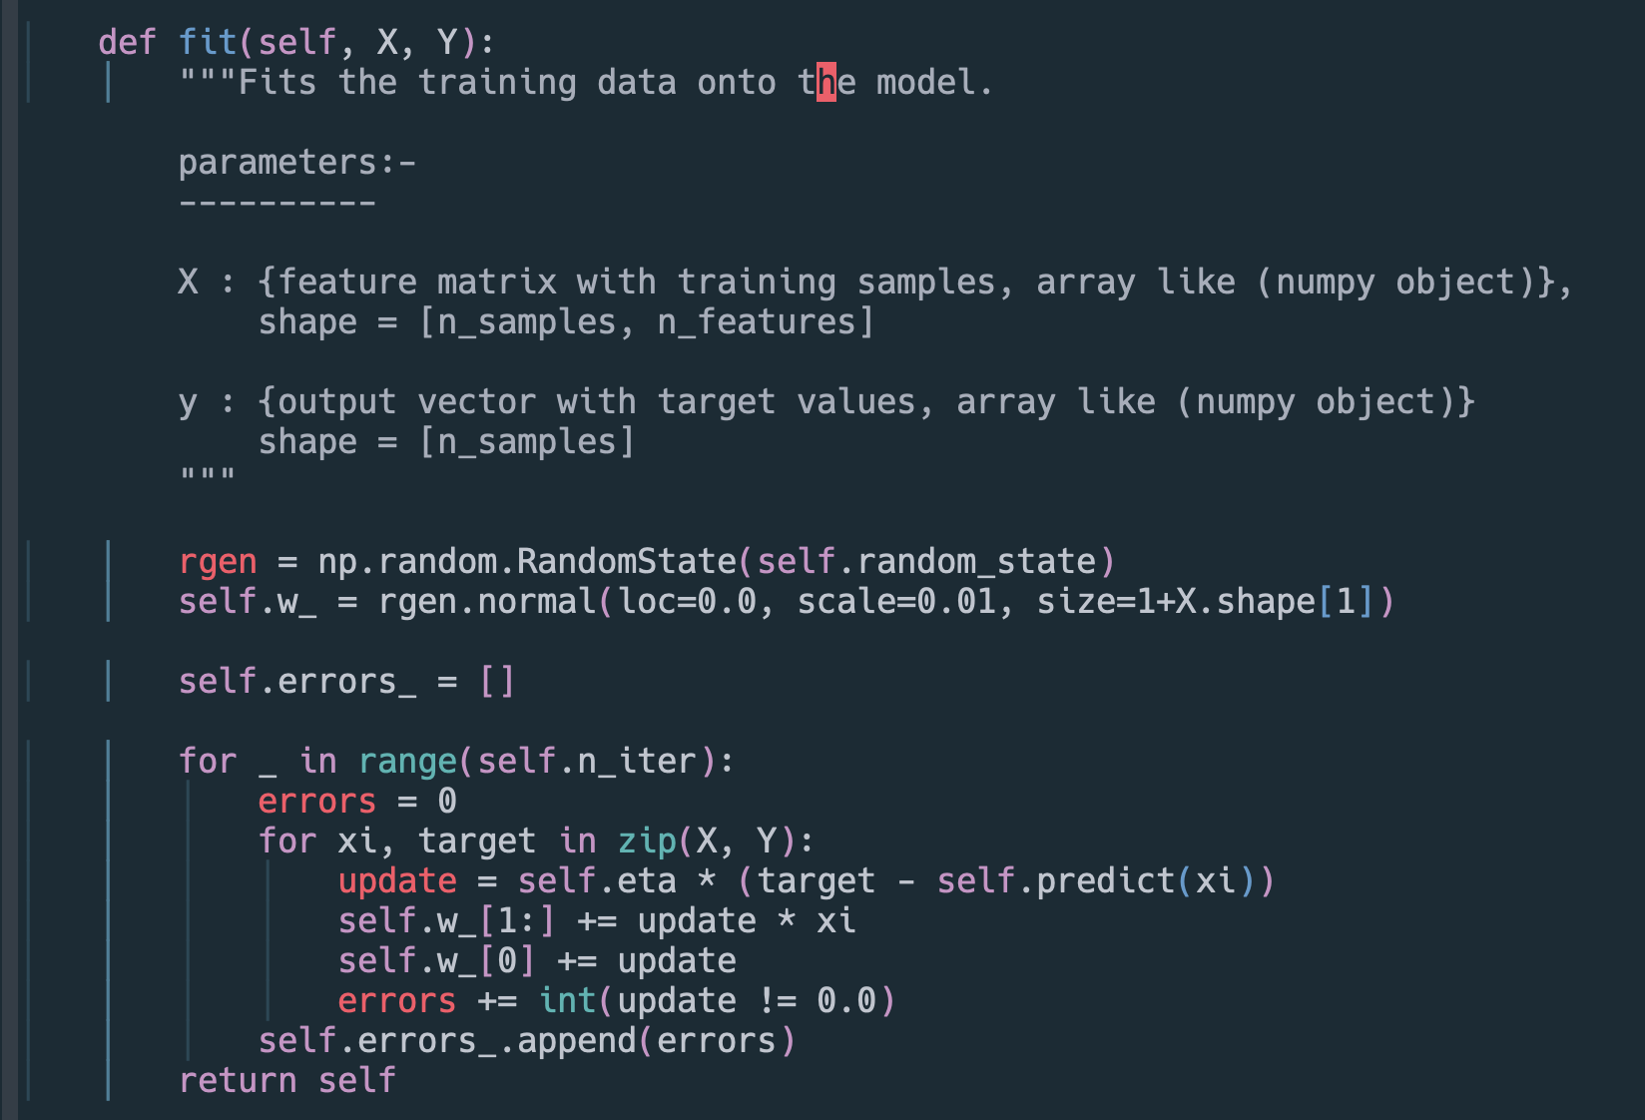
The fit method

Slide 42
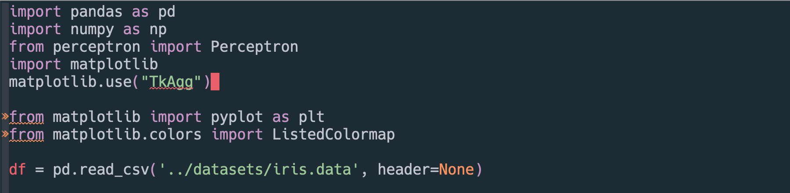
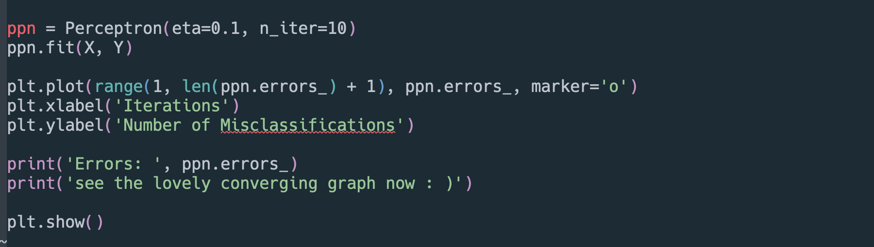
Training and plotting the Perceptron

Slide 43
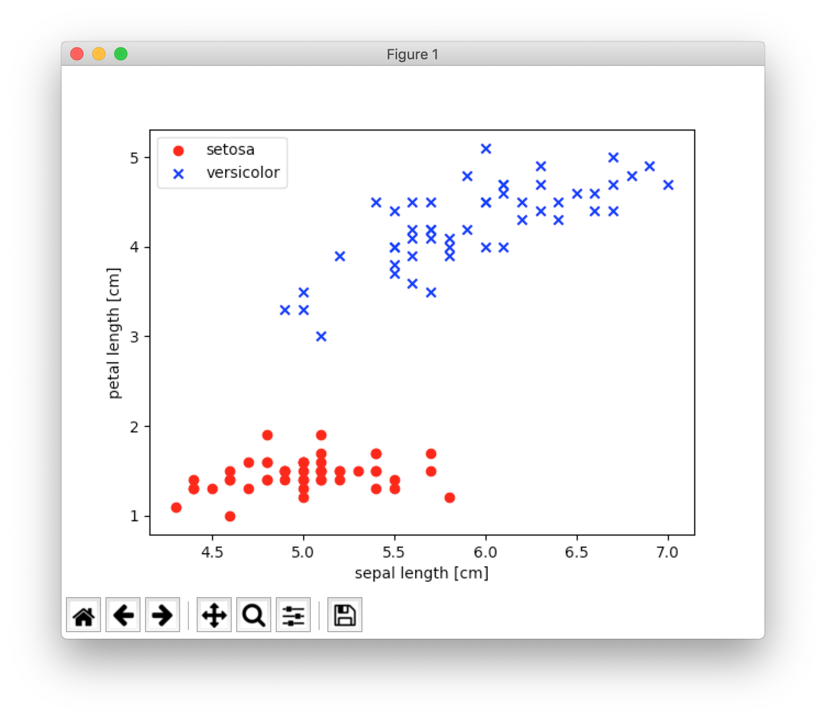

Slide 44
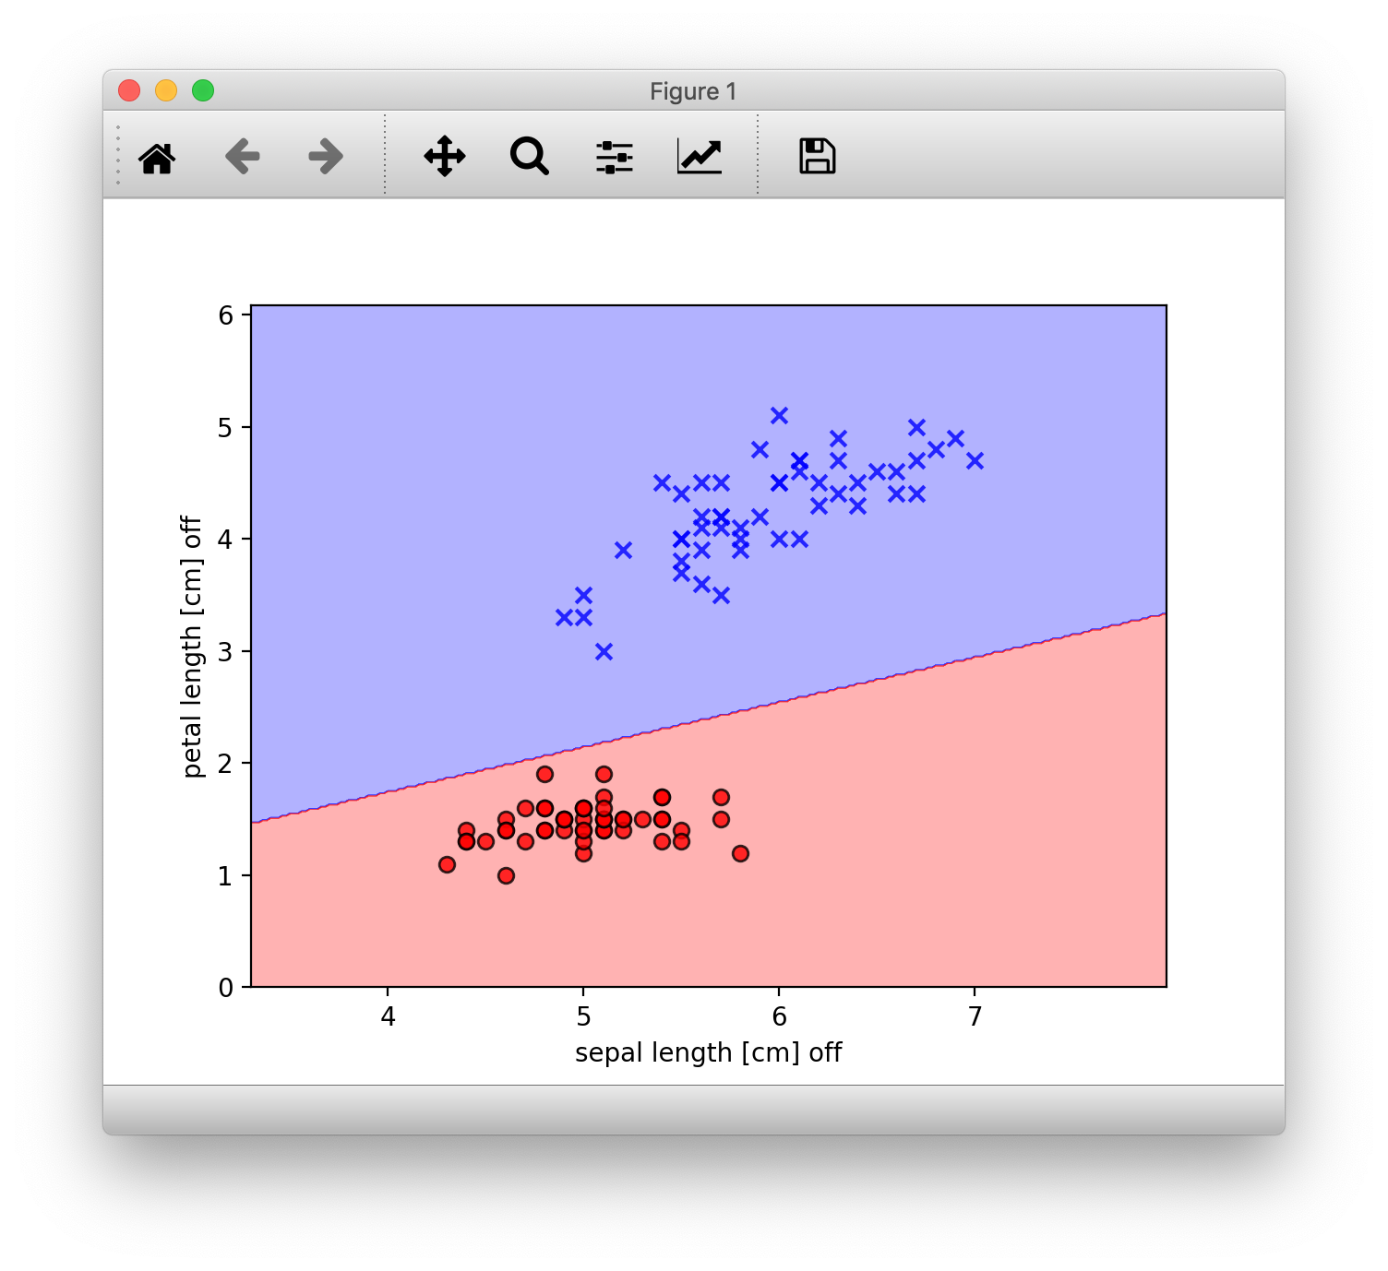
How the scikit-learn Model performed

Slide 45
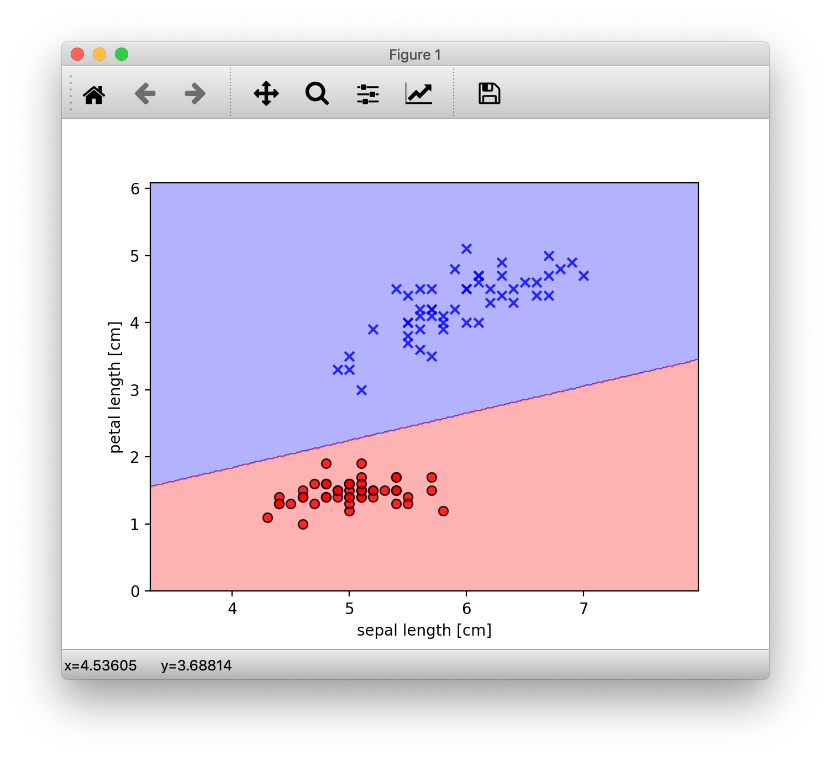
How our handmade model performed

Slide 46
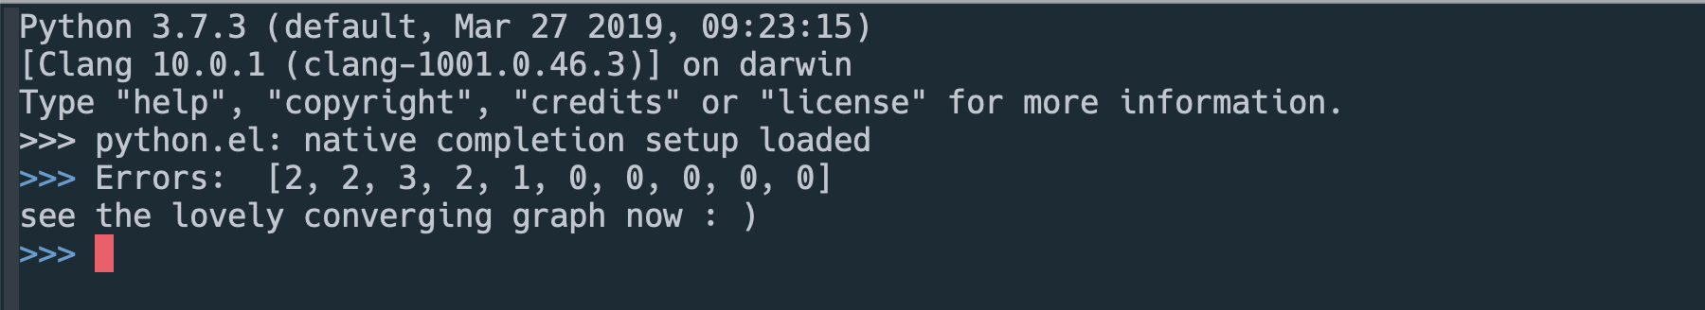
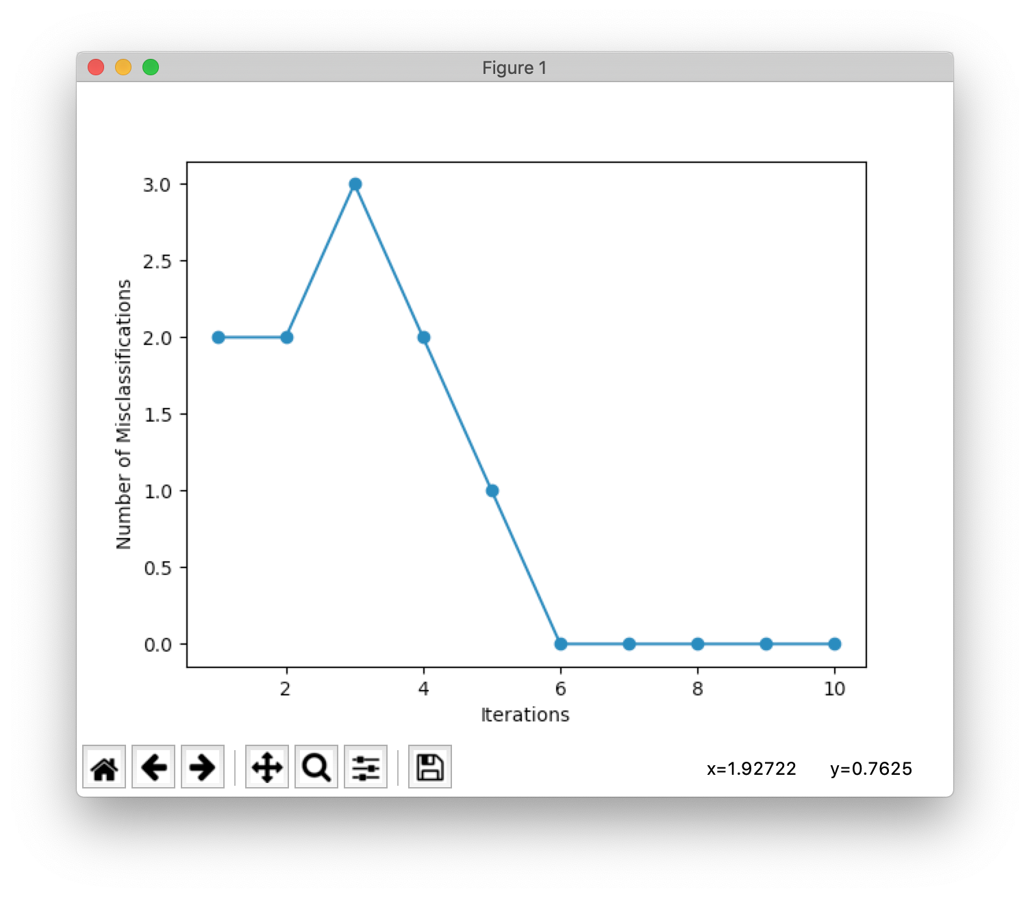

Slide 47
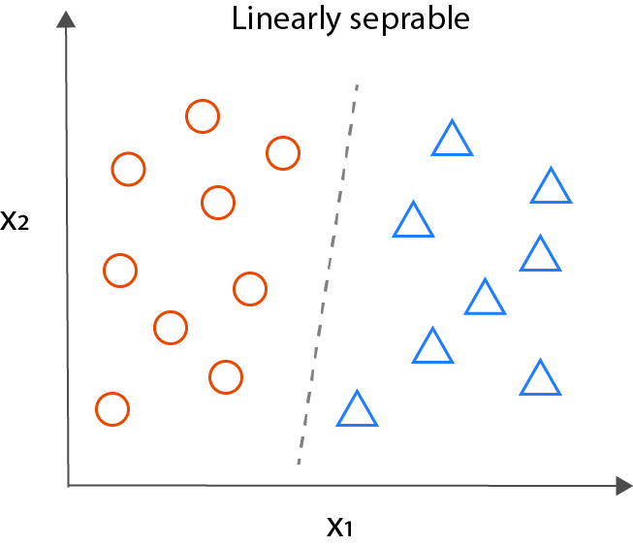
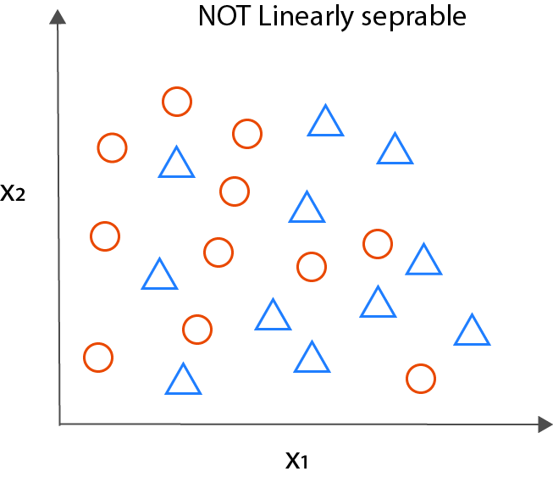
Drawbacks
The Perceptron, even though simple in design and elegant in its working has glaring drawback. IT Only seems to work when
THE CLASSES ARE LINEARLY SEPARABLE i.e a clear linear separation / boundary
Learning rate is not too high
If these conditions are not satisfied, the learning rule will never stop updating since some samples will always be mis-classified and would need weight updates, changing the decision boundary.
Since most of the data in the wild is rarely linearly separable, so, to overcome these, we set
The limit the max number of passes over dataset (epochs) And / or
Threshold for number of misclassifications.

Slide 48
The Adaptive Linear Neuron or
AdaLiNe algorithm

Slide 49
Importance.
Adaline is very similar to perceptron, with a few differences and addition of a few key new concepts
The Adaptive Linear Neuron or ADALINE is a binary classification algorithm and a single layer neural network which was published by Bernard Widrow and his doctoral student Tedd Hoff (also known as Widrow-Hoff rule) shortly after Rosenblatt’s perceptron algorithm and can be thought of as an improvement on the later.
Illustrates the key concept of defining and optimising a continuous cost function which really lays the foundational groundwork for understanding more sophisticated Machine learning algorithms like Logistic Regression, Support - Vector Machines etc.

Slide 50
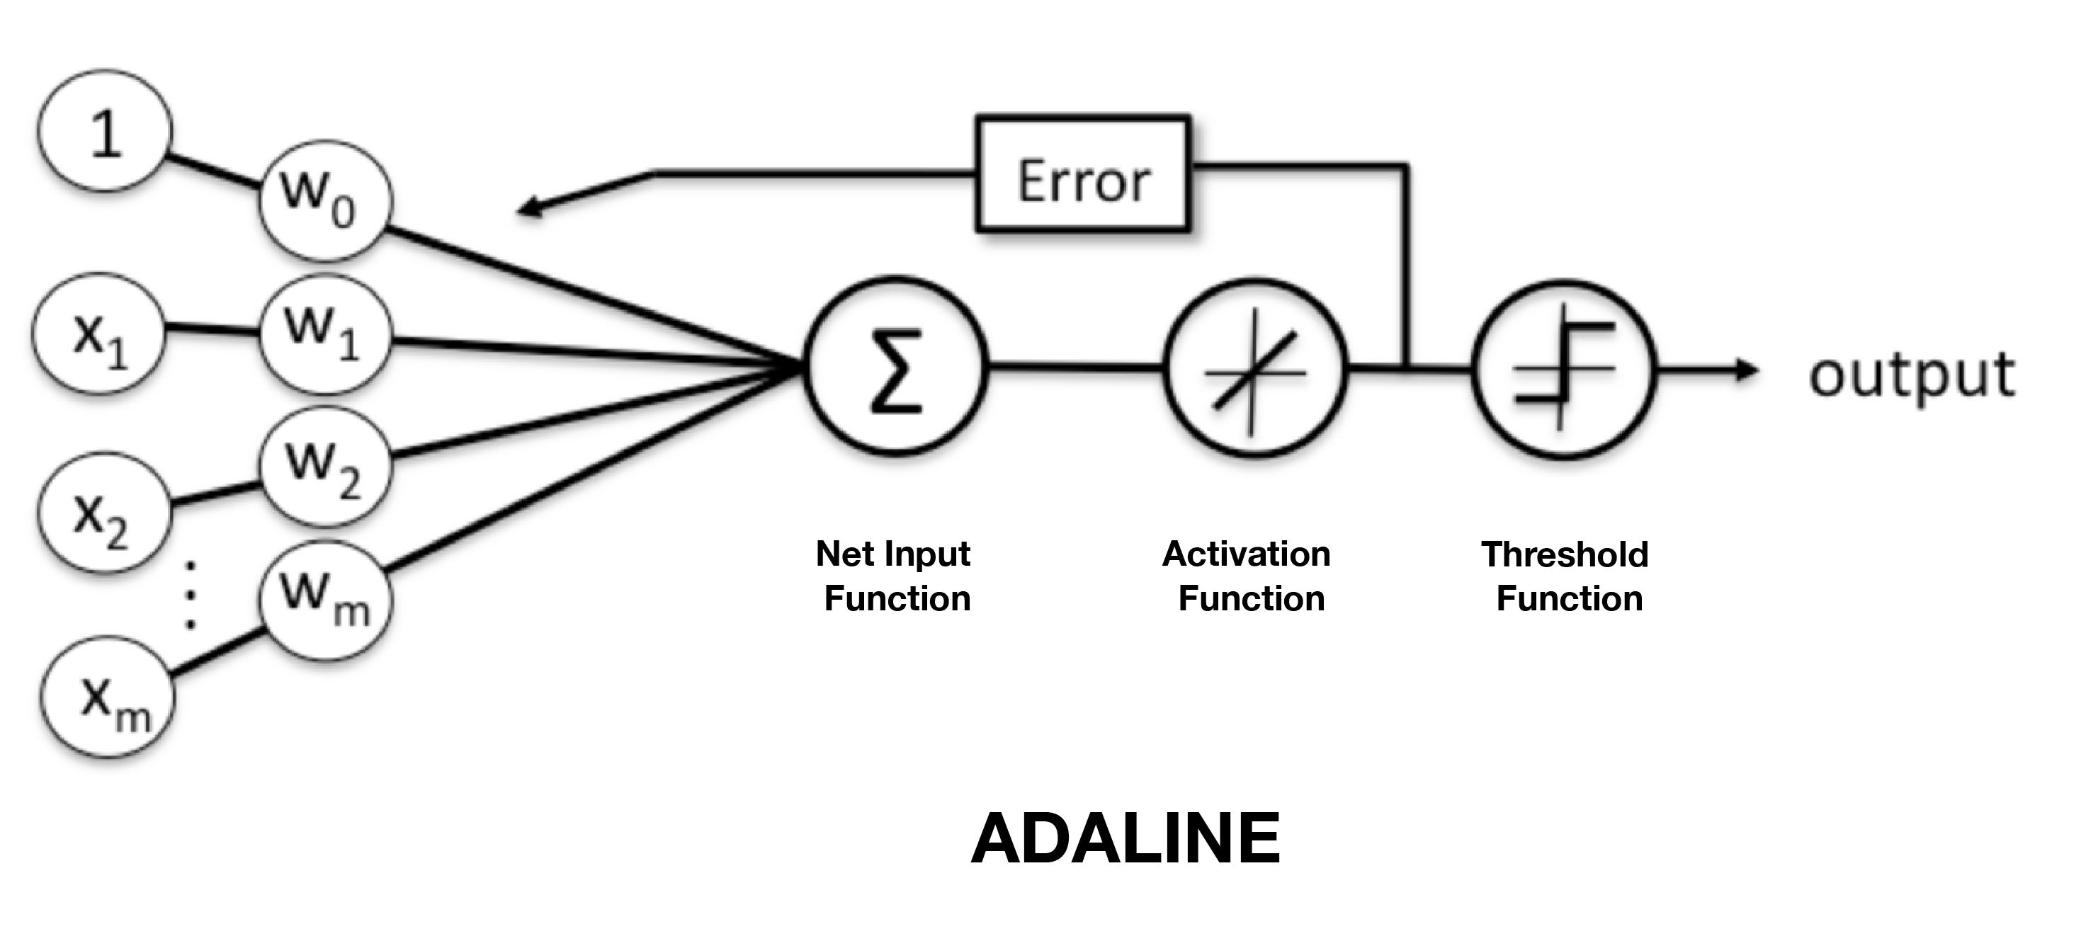
The Schematic

Slide 51
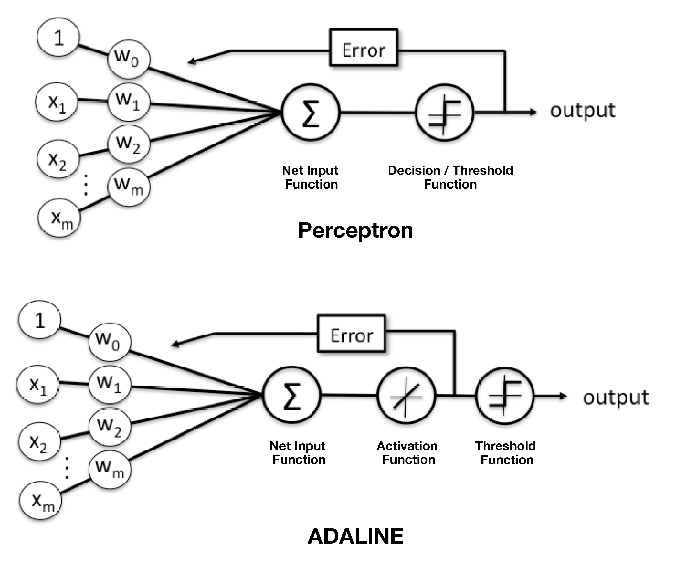
The Difference

Slide 52
Key Differences
The Weights in Adaline are updated via the activation function and not the threshold function like Perceptron
The Activation function in Adaline is simply the identity function of the net input $ϕ(z)=z,\text{where}z=w^{T}x$ which is real-valued i.e not necessarily an integer like 0 or 1.
Adaline uses continuous predicted values (from the net input) to learn the model coefficients, which is more “powerful” since it tells us by “how much” we were right or wrong
Perceptron compares the true-class labels against the predicted class labels and then calculates the error, whereas, Adaline compares this real valued output to TRUE-CLASS LABLES and the error is decided based on the calculation.
Adaline uses COST-FUNCTION MINIMIZATION and GRADIENT DESCEND
In Perceptron, the Weights are updated incrementally after each data sample is processed, whereas in case of Adaline, the weight updates are calculated based on all training samples in the training set.

Slide 53
Cost Function Minimization
One of the central features of machine learning algorithms, esp. supervised ML algorithms is a well defined objective function that is to be optimized while the algorithm learns. This objective function often manifests as a cost function, which, as the name suggests, needs to be minimized.
The Algorithm then learns in a way so as to optimise, (in our case, as we’ll see, minimize the cost) for this objective function.
For example:-
When travelling, you could optimize for:-
Time:- you would then take actions that’ll take you to your destination the fastest, no matter what they cost.
Cost:- you would probably take cheaper means of transport even if they take more time.
The cost function for Adaline is defined as sum of squared errors (SSE), which in turn would be used to learn the weights by the algorithm.
$J(w)=\frac{1}{2}\underset{i}{∑}(y^{(i)}-ϕ(z^{(i)}))^{2}$
$y^{(i)}$ = true class label, $ϕ(z^{(i)})$ = net output from linear activation function (real - valued)

Slide 54
Benefits of this cost function
The continuous linear activation function makes the cost function differentiable, a property which will come in handy when make use of the gradient (slope)
The Cost function is convex (an upward opening parabola)
Both of these above factors, when combined, enable us to use a powerful optimisation technique called GRADIENT DESCENT, which really helps us find weights that optimally minimise the cost function for our classification task.

Slide 55
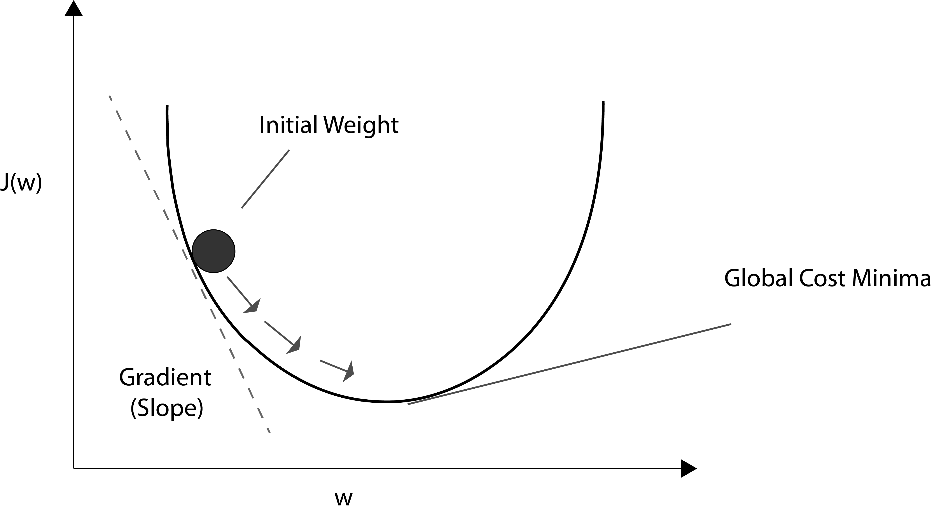
Gradient Decent
The Main idea here can be thought of as climbing or going downhill until a local or global cost minimum is reached.
In each pass over data, we take a step in the opposite direction of the gradient.
(thus ensuring moving towards minimum direction in a convex function)
(if the learning rate is too high, we WILL overshoot, thus a well-suited rate is required)
The step size is determined by the learning rate we decide upon when starting the classifier.

Slide 56
Adaline Learning Rule
The Adaline learning rule
$w:=w+Δw$ Seems pretty similar to Perceptron learning rule
Here, Using Gradient Decent technique, we update the weights by taking a step in the opposite direction of the gradient $∇J(w)$ of our cost function $J(w)$
$$Δw=-η∇J(w)$$
where, $η$ is the learning rate.
To Compute the Gradient of the cost function, we need to compute the partial derivative of the cost function w.r.t each weight $w_{j}$
IF
$$\frac{∂J}{∂w_{j}}=-\underset{i}{∑}\left(y^{(i)}-ϕ\left(z^{(i)}\right)\right)x_{j}^{(i)}$$
Then
$$Δw_{j}=-η\frac{∂J}{∂w_{j}}=η\underset{i}{∑}\left(y^{(i)}-ϕ\left(z^{(i)}\right)\right)x_{j}^{(i)}$$
(This is what we get when we partially differentiate our cost function)
Since we update all weights Simultaneously, our adaline rule is Still
$$w:=w+Δw$$

Slide 57
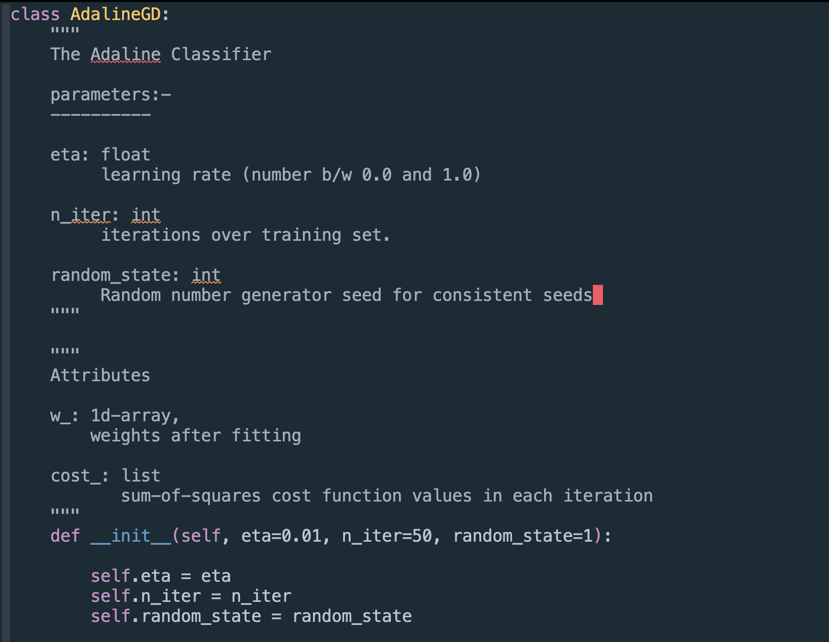
Writing your own AdaLiNe Classifier in Python
The init method

Slide 58
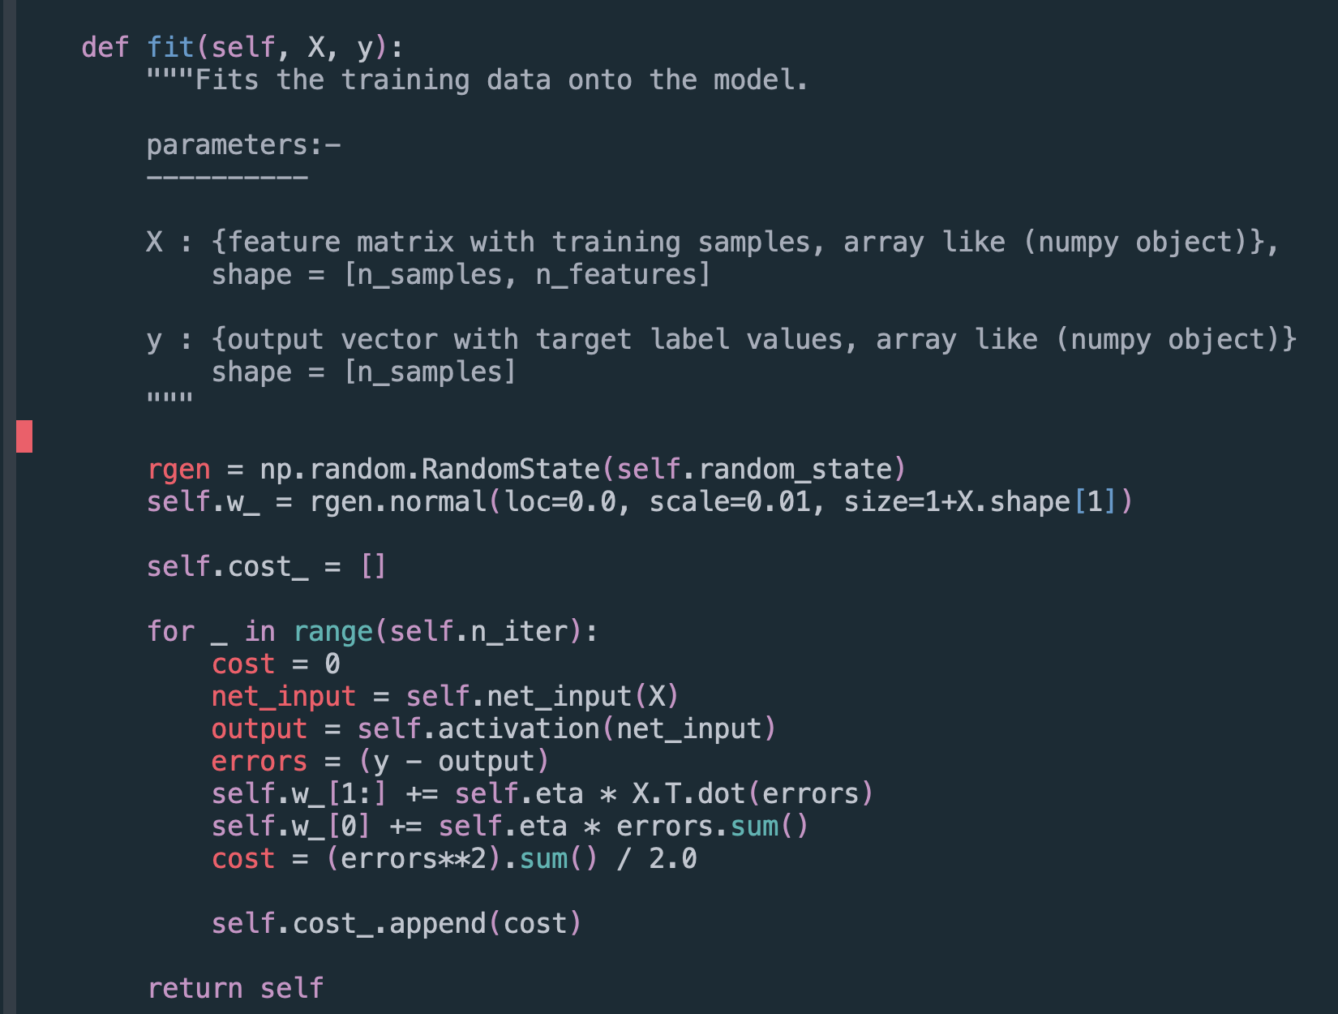
The Fit method

Slide 59
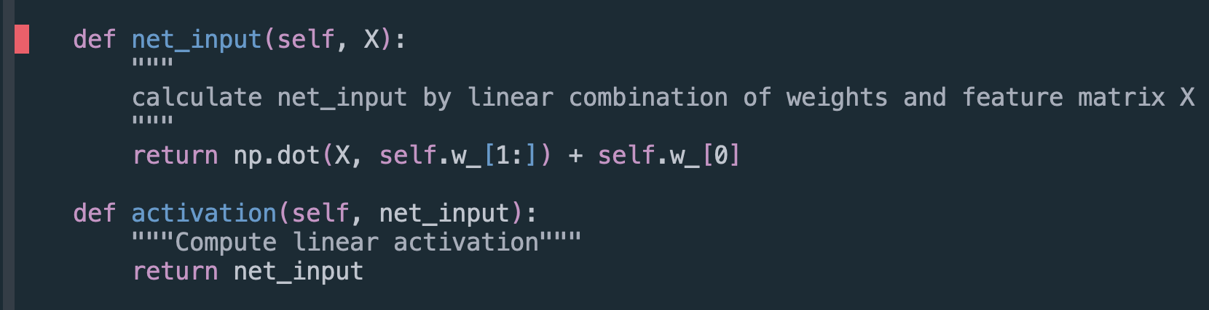
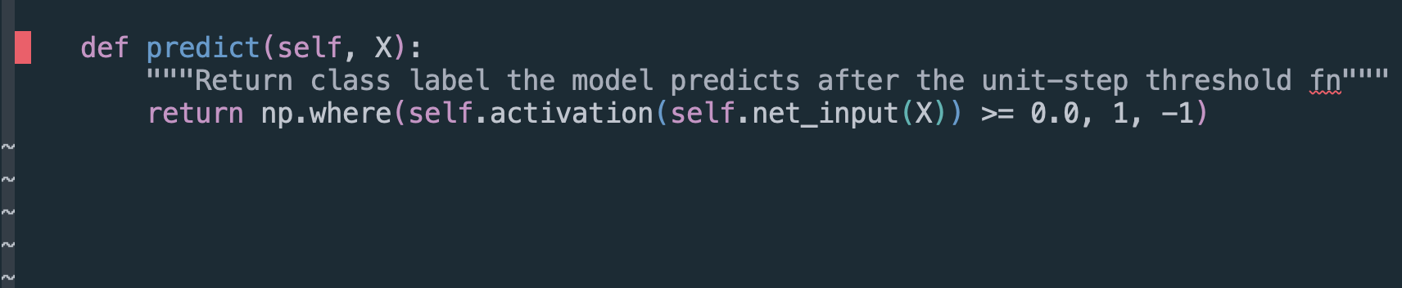
The net_input and activation methods
The predict method

Slide 60
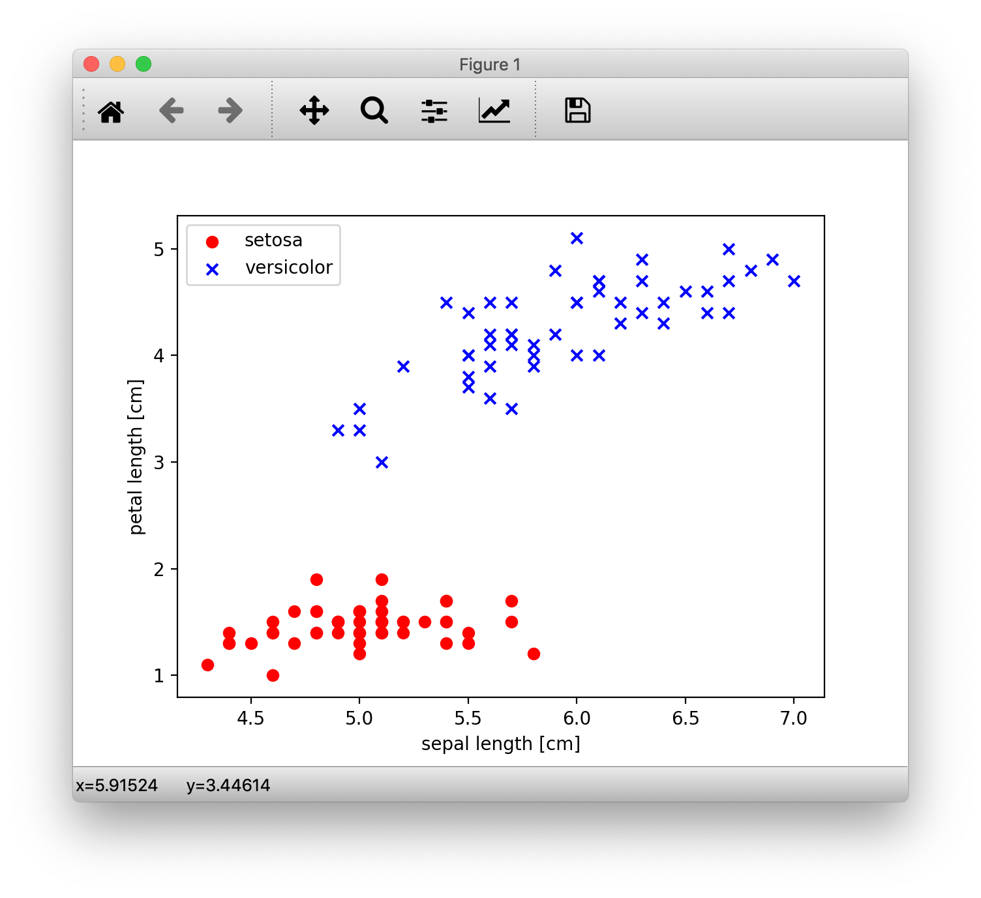

Slide 61
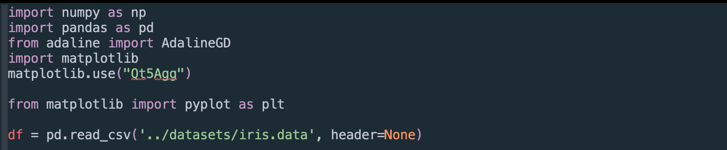
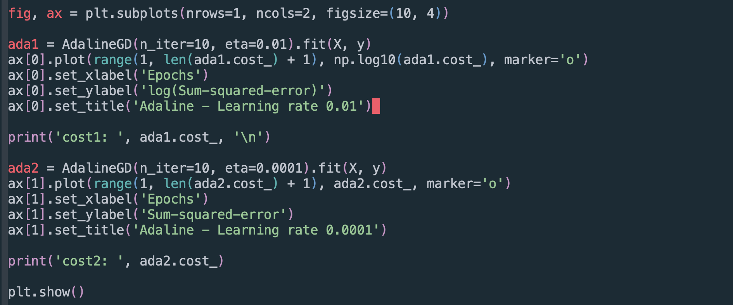
* Notice the two instances of Adaline classifier with same data but different learning rates.

Slide 62
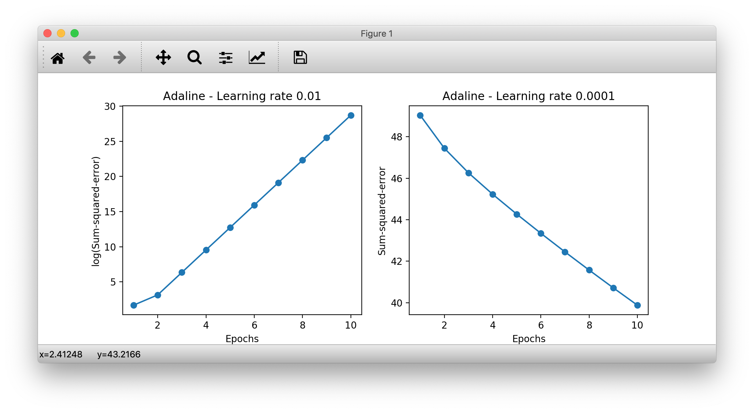
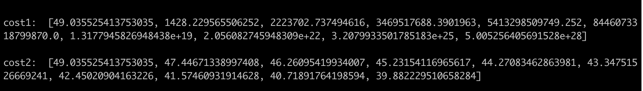
* Notice the Costs of two Adaline classifiers with same data but different learning rates.

Slide 63
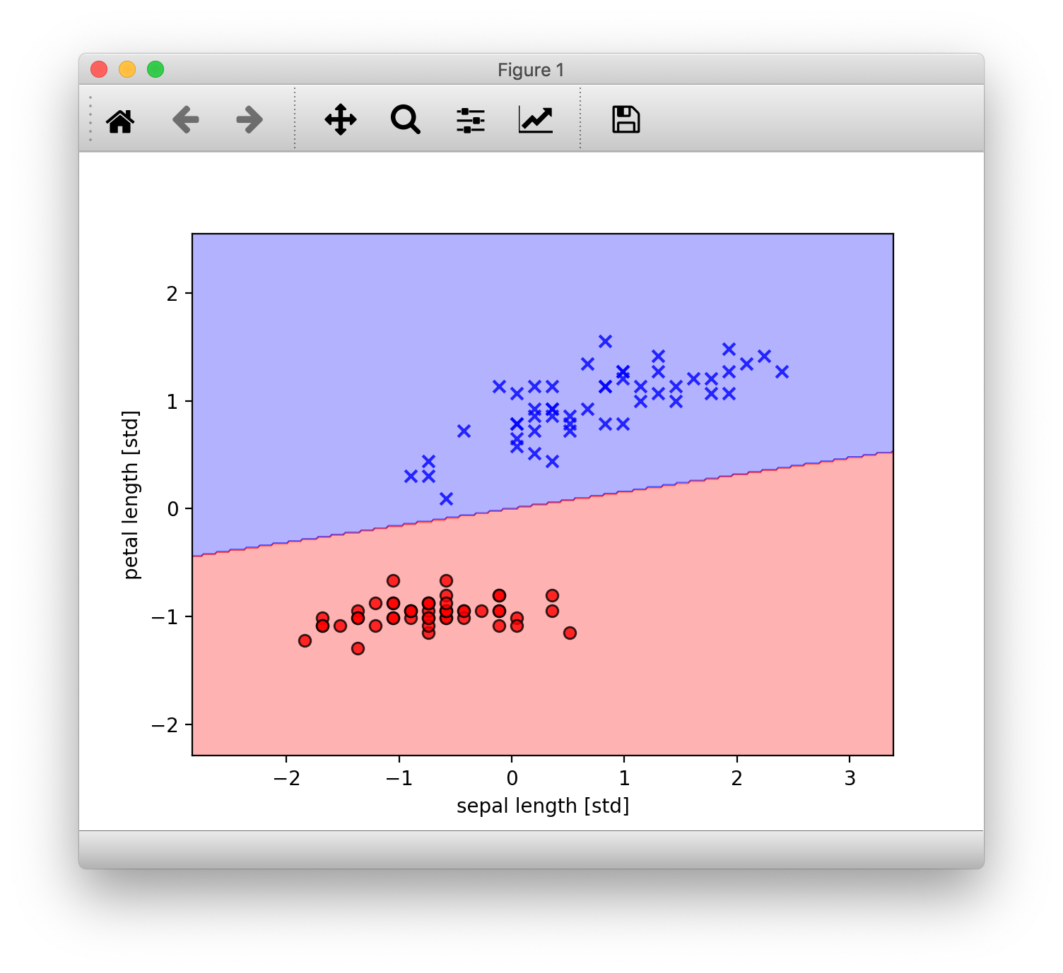
How the model performed with learning rate 1

Slide 64
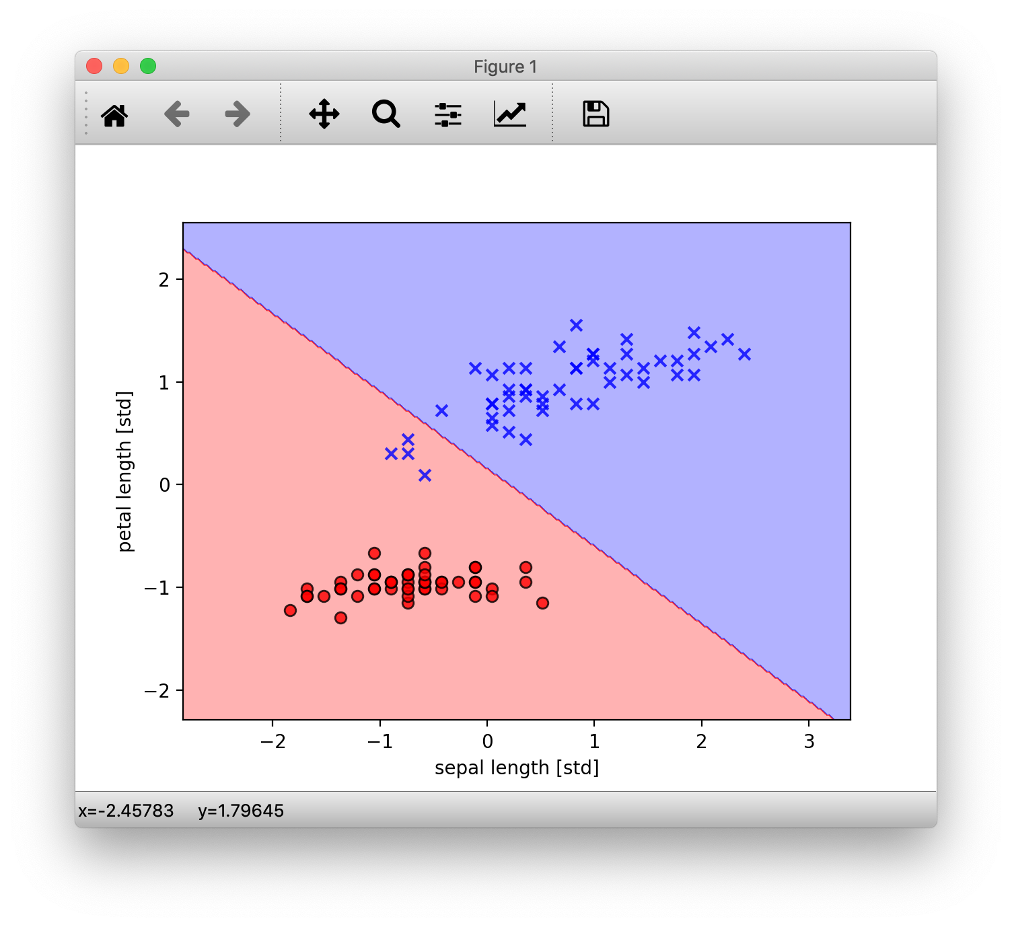
How the model performed with learning rate 2

Slide 65
The Logistic Regression Algorithm.

Slide 66
Logistic Regression
Logistic Regression is one of the most widely used algorithms for classification in the industry today.
Inspite of the name, Logistic Regression, just like the previously discussed Adaline model is a linear model for binary classification and NOT regression. It just as-well can be extended to work as a multi-class classifier via using techniques like the OneVersesRest(OvR) technique.
The reasons for Logistic Regression’s popularity?
- It is an relatively easy model to implement and understand
- Performs very well on linearly separable data classes.
Logistic Regression is a lot similar to Adaline model but, with a different activation and cost functions, as we will see, this is where it all comes together.

Slide 67
New Terms and Functions
Odds ratio:
The odds in favour of a particular event, the odds ratio can be written as $\frac{p}{1-p}$ where $p$ is the probability of the positive* event. (* positive = the event we are looking for, not necessarily in a good context, eg: presence of a disease)
LOGIT Function:-
$logit(p)=log\frac{p}{1-p}$ , or more clearly as the natural logarithm of the odds ratio.
Where again $p$ is the probability of positive event.
The logit function takes input values in the range 0 to 1 and transforms them to values over the entire real-number range. i.e $[0,1]->(-∞,+∞)$, which we can use to express a linear relationship between feature values and log-odds:
$logit(p(y=1|x))=w_{1}x_{1}+w_{2}x_{2}+…+w_{m}x_{m}=\overset{m}{\underset{i=0}{∑}}w_{i}x_{i}=w^{T}x$
here, $p(y=1|x)$ is the conditional probability that a particular sample belongs to class 1 given features $x$.

Slide 68
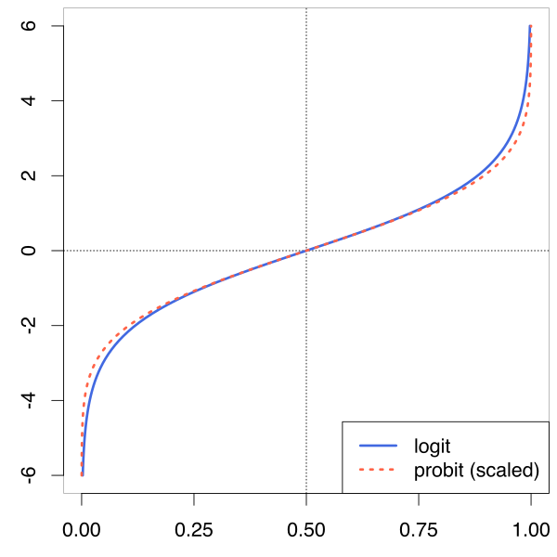
What LOGIT function looks like
Input Domain ( $z$ ):- [0, 1]
Output Range $ϕ(z)$ :- $(-∞,+∞)$

Slide 69
SIGMOID Function:-
we are actually interested in predicting the probability that a certain sample belongs to a class, which is the inverse form of logit function. It is also called the logistic sigmoid function, often referred to as simply the sigmoid function because of its characteristic S-shape:
$ϕ(z)=\frac{1}{1+e^{-z}}$
Where $z$ is the net input, i.e. the linear combination of the weights and sample features, $z=w^{T}x=w_{0}x_{0}+w_{1}x_{1}...w_{m}x_{m}$
its input domain, z is from $(-∞,+∞)$ and output Range is [0, 1], Exactly the opposite of the logit function that we’ve seen earlier. This is perfect as the function takes in real number values and outputs a value between [0, 1] inclusive which can be used as a probability measure.
Input Domain:- $(-∞,+∞)$
Output Range:- [0, 1]

Slide 70
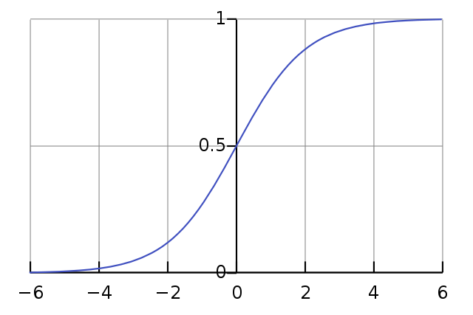
What SIGMOID function looks like
We can see from the definition that :-
$ϕ(z)->1$ , if
$z->∞$ , as
$e^{-z}$ becomes dismally small and in the denominator
AND
$$ϕ(z)$$
$ϕ(z)->0$ , when
$z->-∞$
There’s an intercept at $ϕ(0)=0.5$
$$z$$

Slide 71
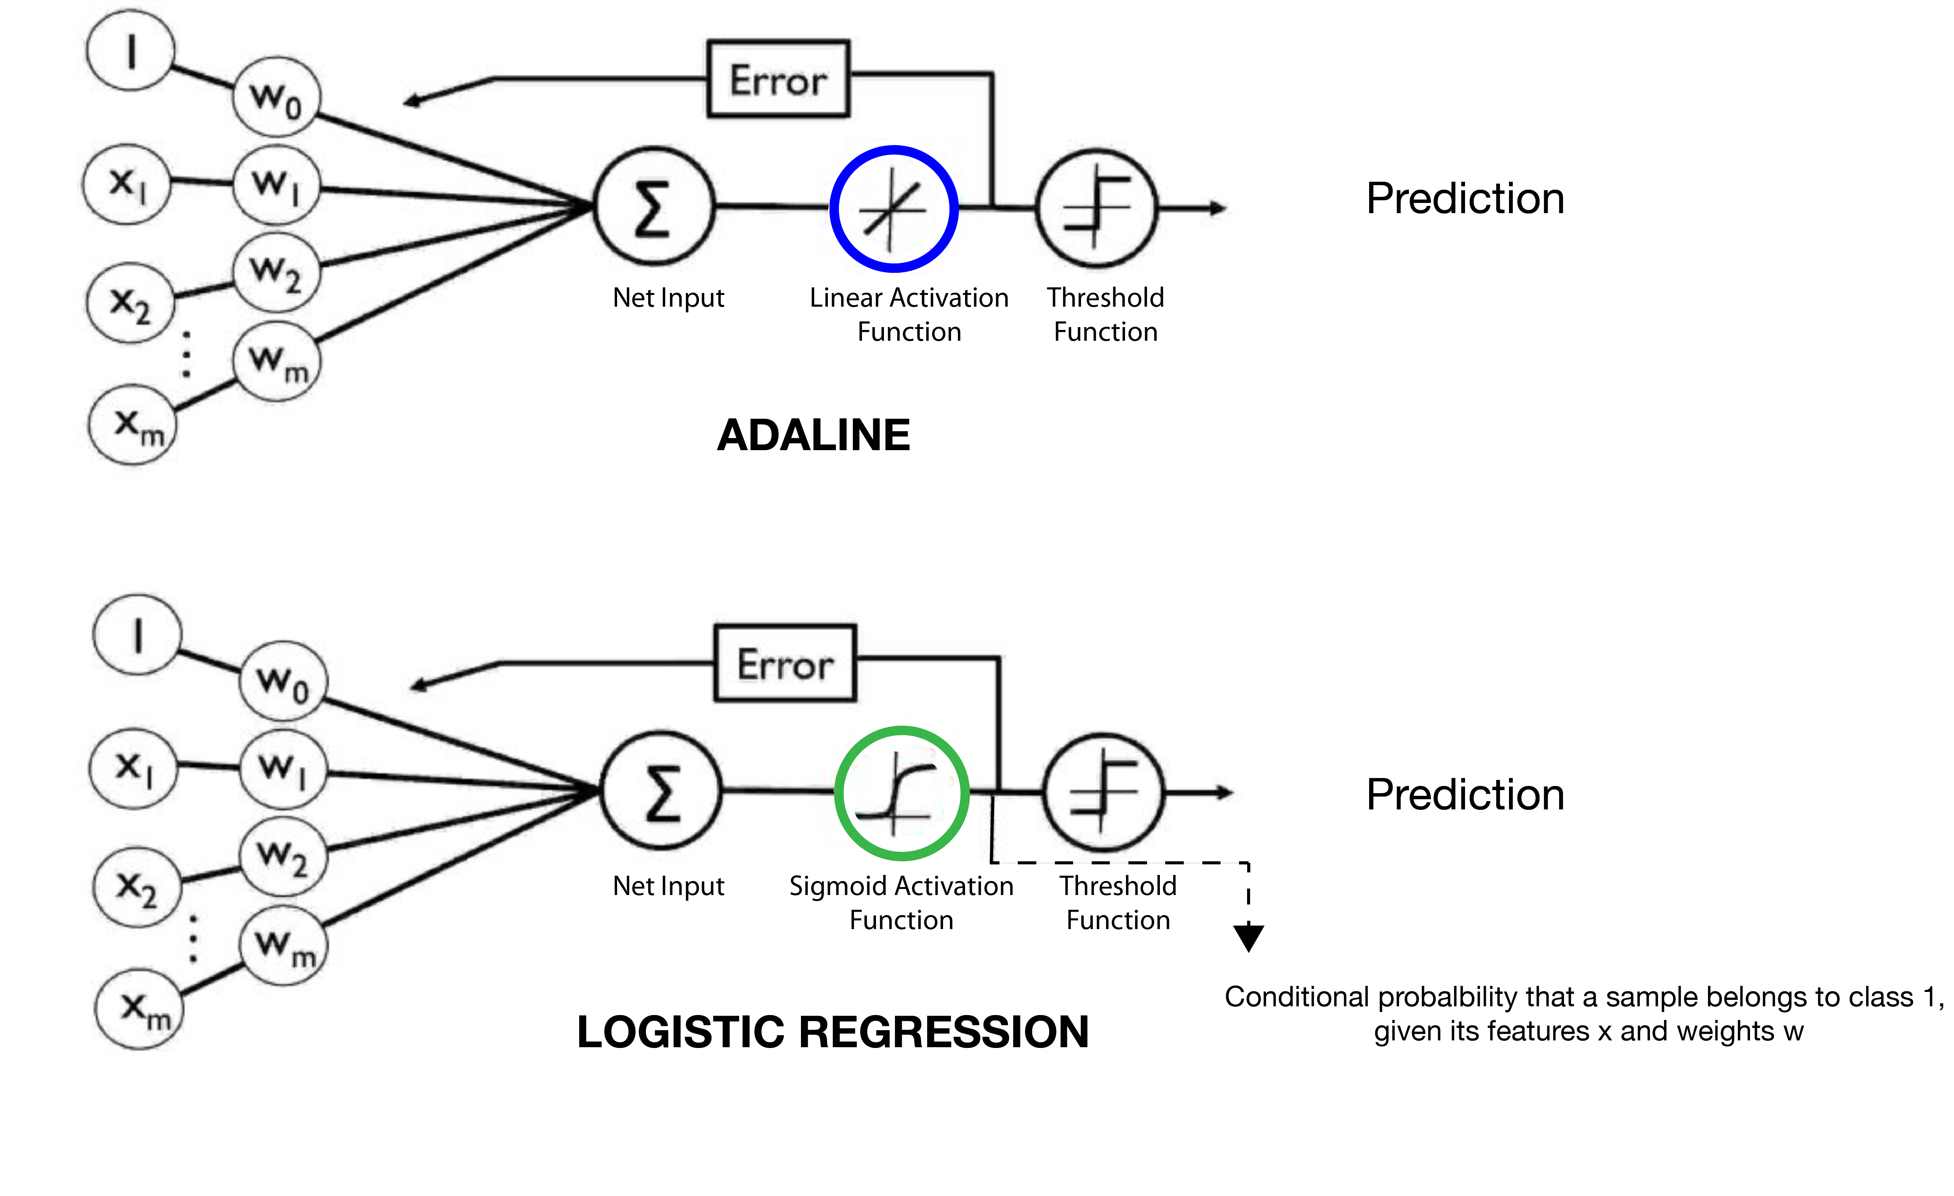
The Schematic

Slide 72
The Cost Function
Remember in Adaline, we used the cost function S.S.E, which we minimized in order to learn weights.
For logistic regression, we want to maximise the likelihood that a sample belongs to a certain class y, given features x and with learned weights w. Let us call this likelihood function $L(w)=P(y|x;w)$.
In practice, it is easier to maximise the natural log of this function, which we call the log likelihood $l(w)=logL(w)$.
Now, we define the cost function $J(w)$ as -$l(w)$, which conversely, we want to minimize. it would actually be equal to maximizing the log likelihood $l(w)$ but with added benefits like being able to use gradient decent and more mathematical ease.
Long story short, the cost function comes out to be.
$$J(w)=\overset{n}{\underset{i=1}{∑}}\left[-y^{(i)}log(\overset{̂}{y})-\left(1-y^{(i)}\right)log(1-\overset{̂}{y})\right]$$

Slide 73
$$J(w)=\overset{n}{\underset{i=1}{∑}}\left[-y^{(i)}log(\overset{̂}{y})-\left(1-y^{(i)}\right)log(1-\overset{̂}{y})\right]$$
Where:-
$y^{(i)}$ is the $i_{th}$ class label in the desired true target vector (1 or 0)
$\overset{̂}{y}=ϕ(z)$, the probability output by the activation function, [0, 1]
To get a better intuition of the function, lets look at cost calculation of a single sample instance:
$J(ϕ(z),y;w)=-ylog(ϕ(z))-(1-y)(log(1-ϕ(z)))$
$$j(ϕ(z),y;w)=\{_{-log(1-ϕ(z))ify=0}^{-log(ϕ(z))ify=1}$$

Slide 74
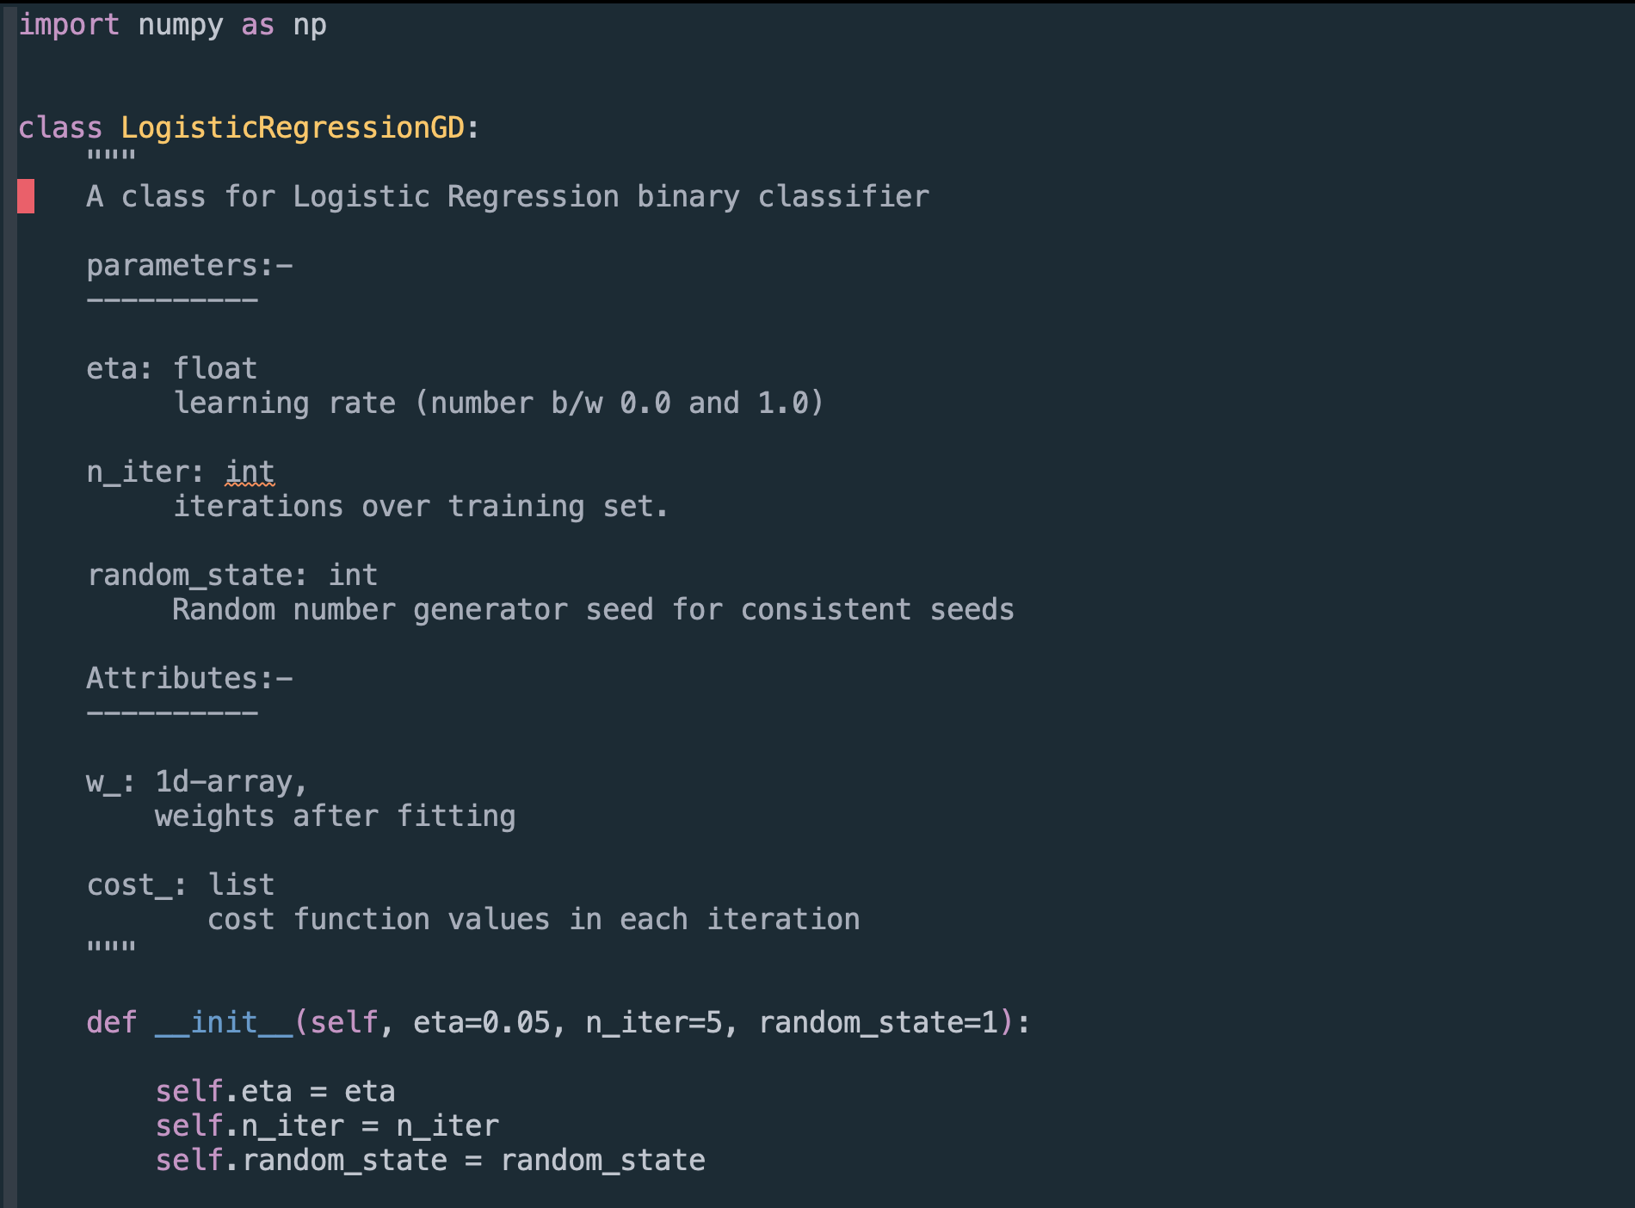
Converting the AdaLiNe Classifier implementation to Logistic Regression
The __init__ method

Slide 75
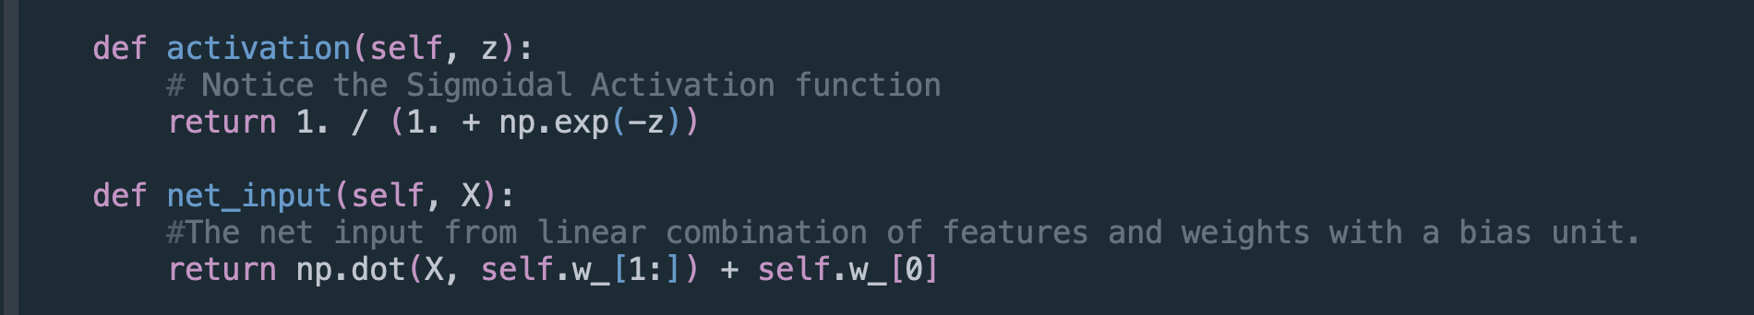
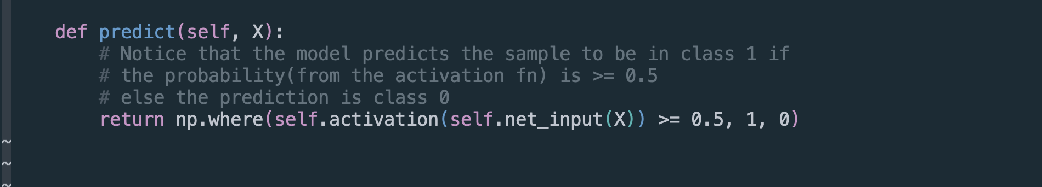
The net_input and activation in Logistic Regression.
The predict method

Slide 76
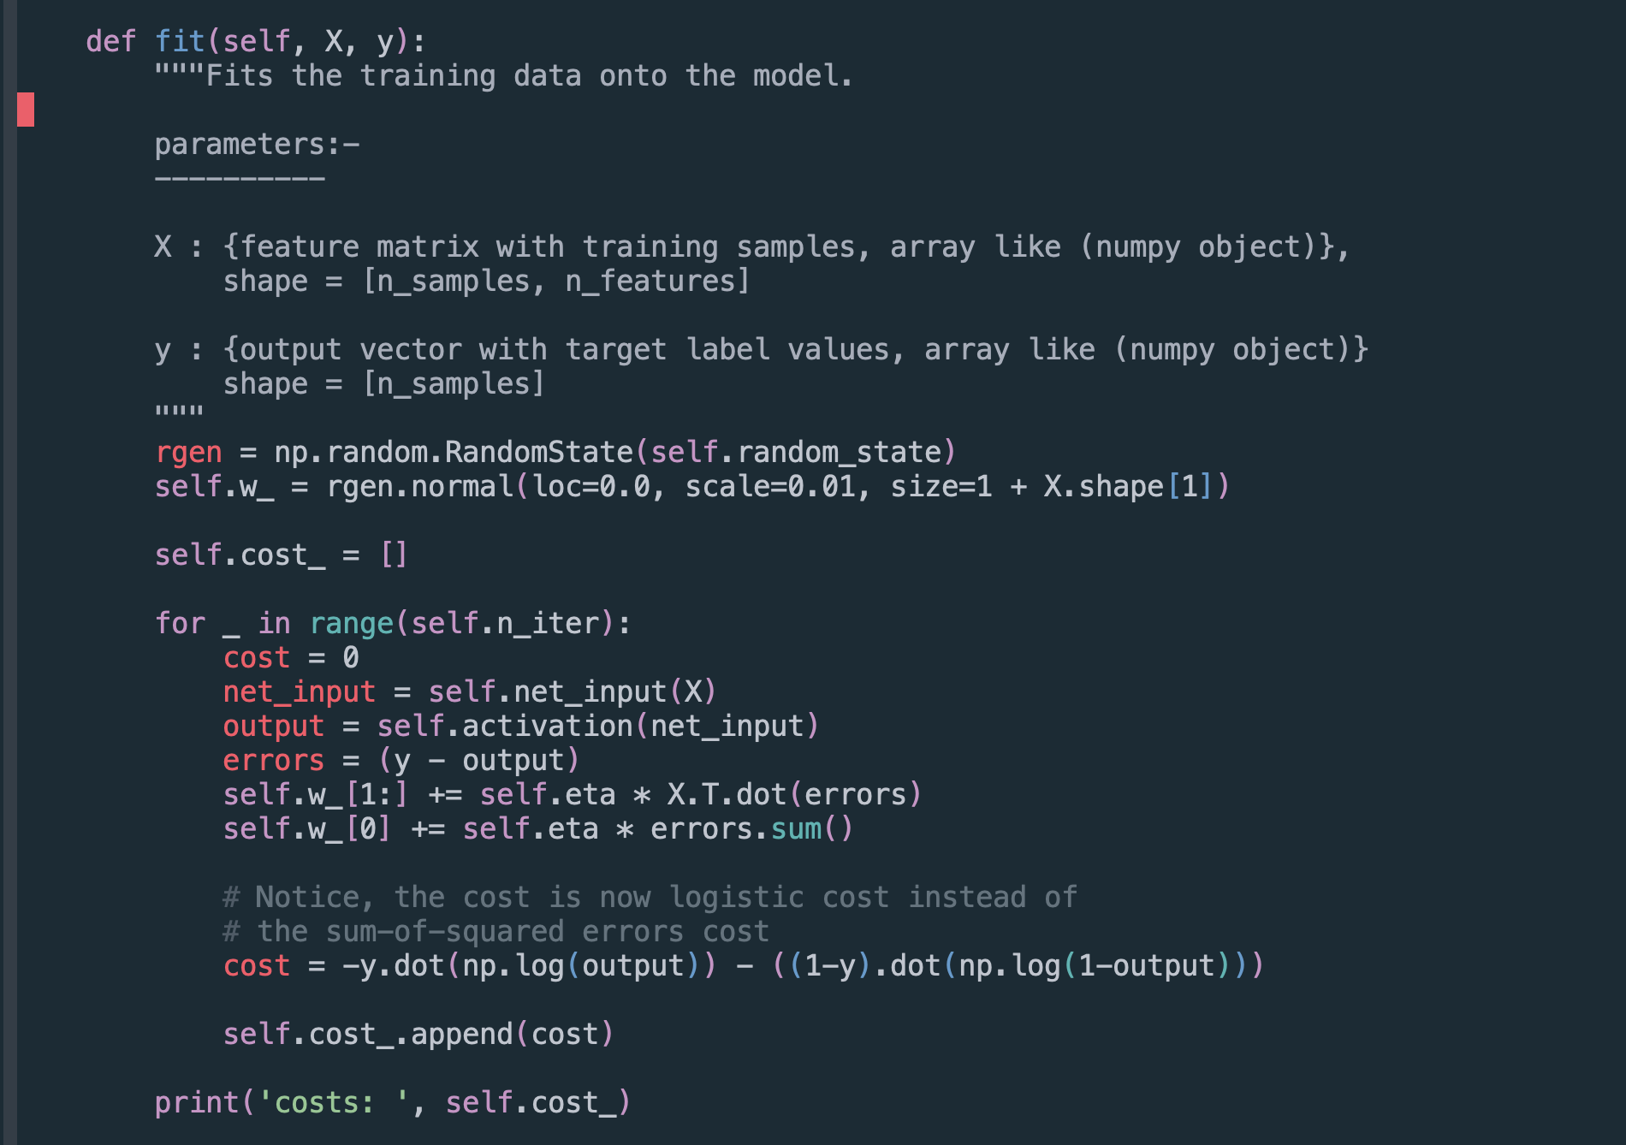
The fit method in Logistic Regression

Slide 77
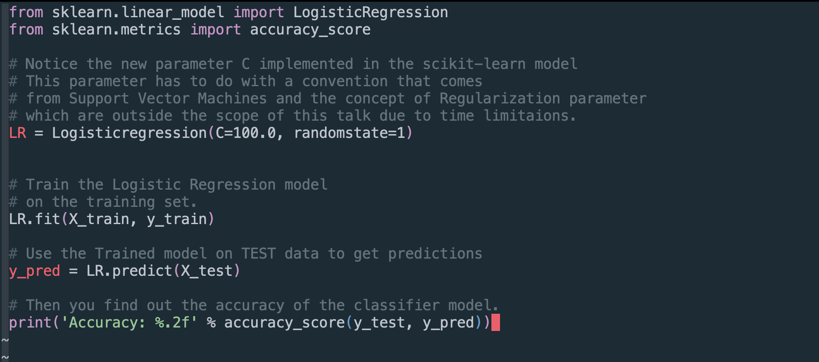
Python Code to train a perceptron model imported form sci-kit learn library

Slide 78
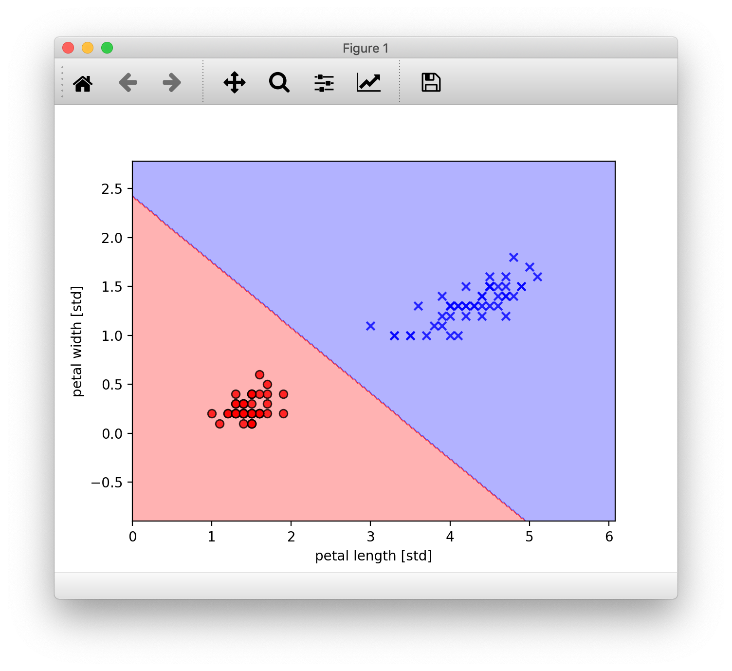
How the Scikit-Learn model performed

Slide 79
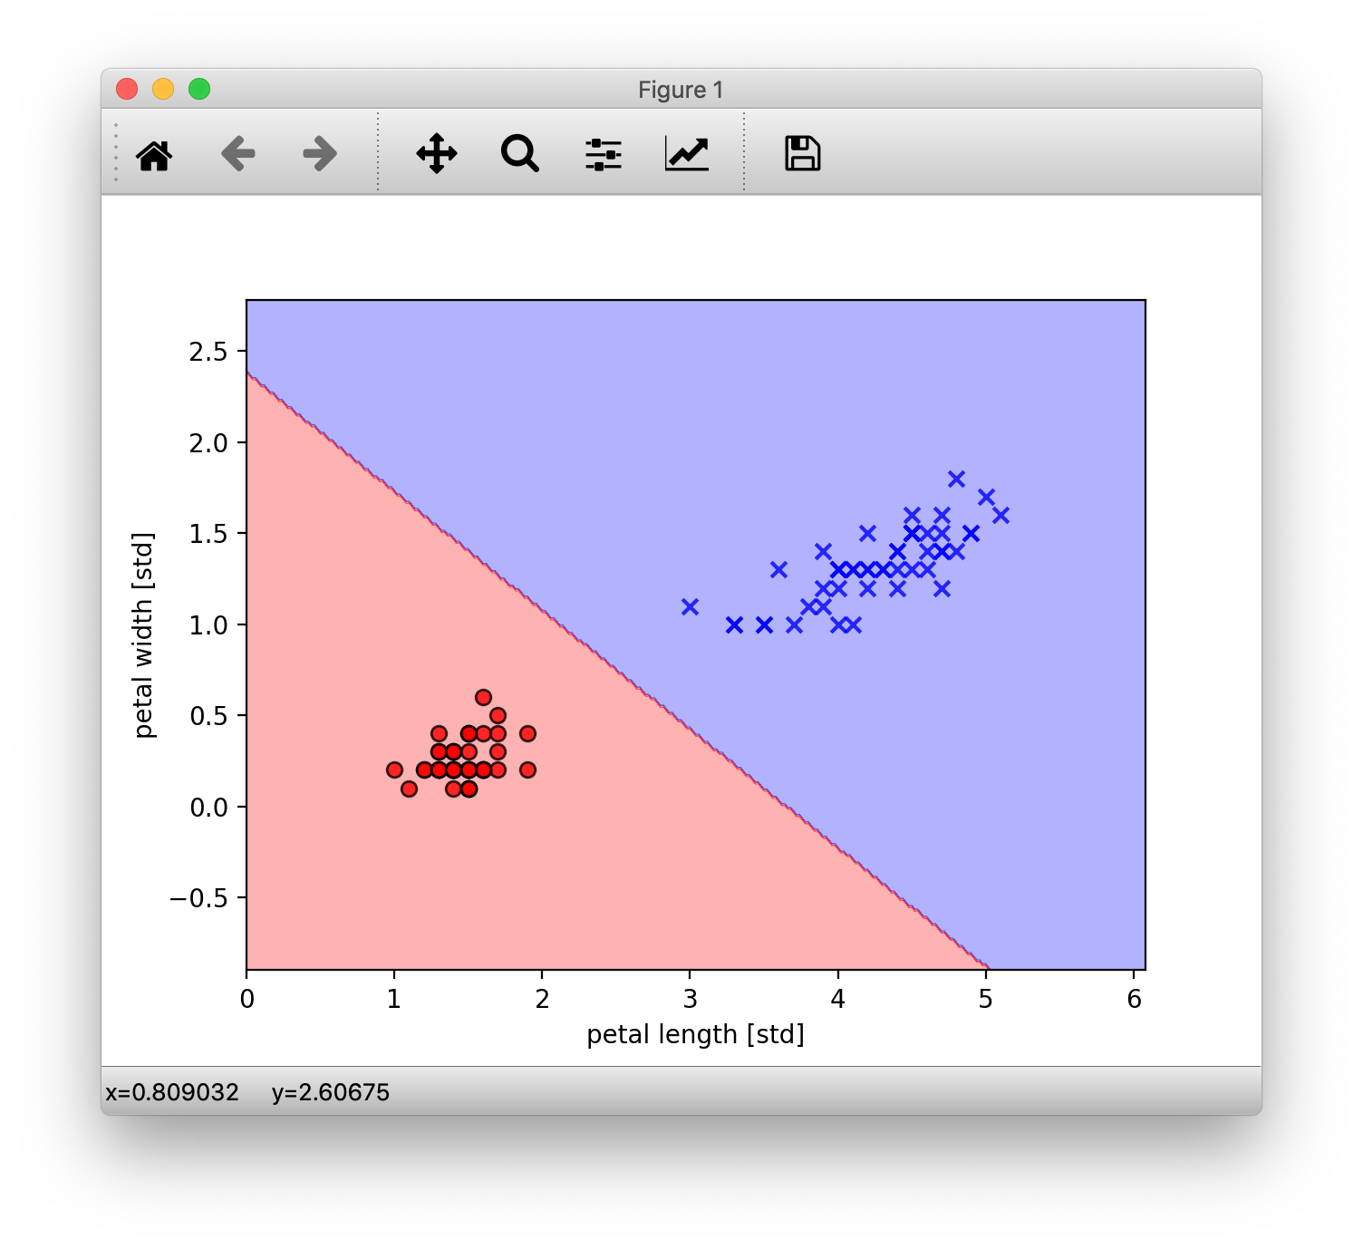
How our handmade model performed

Slide 80
Chapter 4
Summary

Slide 81
YOU Learned
YOU learned What is Machine learning and the big picture of the field.
YOU Learned Various types and categories of the broad Field of ML and that learning is just a part of the entire equation now.
YOU Learned The Very Core fundamental Machine Learning algorithms and what happens under-the-hood when you use these classifier algorithms and how they work.
The Perceptron
The Adaline
The Logistic Regression
With Powerful Techniques like Gradient Decent.
YOU Learned:-
The Necessary Math behind these algorithms and how they build upon each other.
How to implement them in python
How the data that you give them is utilised by these algorithms to LEARN and make a prediction.

Slide 82
Learnings and Outro

Slide 83
WHY YOU SHOULD TOO.
Machine Learning is much less of magic than it is made out to be by the media and is backed by hard science.
Data is hard.
Even though black-boxes exist to save you time and are often optimized and more efficient than ad hoc implementations, It’s ALRIGHT to sometimes want to look inside these black boxes and learn how they work, even though you don’t really NEED to.
People often give the example of driving a car and not knowing how the engine, that they use daily, works. Because they don’t need to. Which is fair enough.
But, think about the days that you car won’t start, or breaks down in the middle of the commute. If you know how the engine works, you can probably figure out or at least narrow down what went wrong and get it fixed and working that much faster. Which, in my humble opinion is always a better position to be in.
Libraries like Scikit-learn and others have done a tremendous job with giving us these highly optimized and easy to use tools. But when you really understand what is going on in there, it will help you in those tricky days where your model won’t behave as you’d like or flat out not work. But now as you know what goes on in there and how the data flows and is utilized, you’d be that much more faster and surer to guess or narrow down what could have gone sideways and that ,i think, makes us better Engineers for it.

Slide 84
THANK YOU FOR LISTENING
❤️

Slide 85
ACKNOWLEDGEMENTS
(WIP)

Slide 86
*Cue to Q/A session with the audience*

